Slide 1


Type 2
DIABETES
The Largest Pandemic in Human History
?
Lifestyle Interventions for Better Health

Slide 2
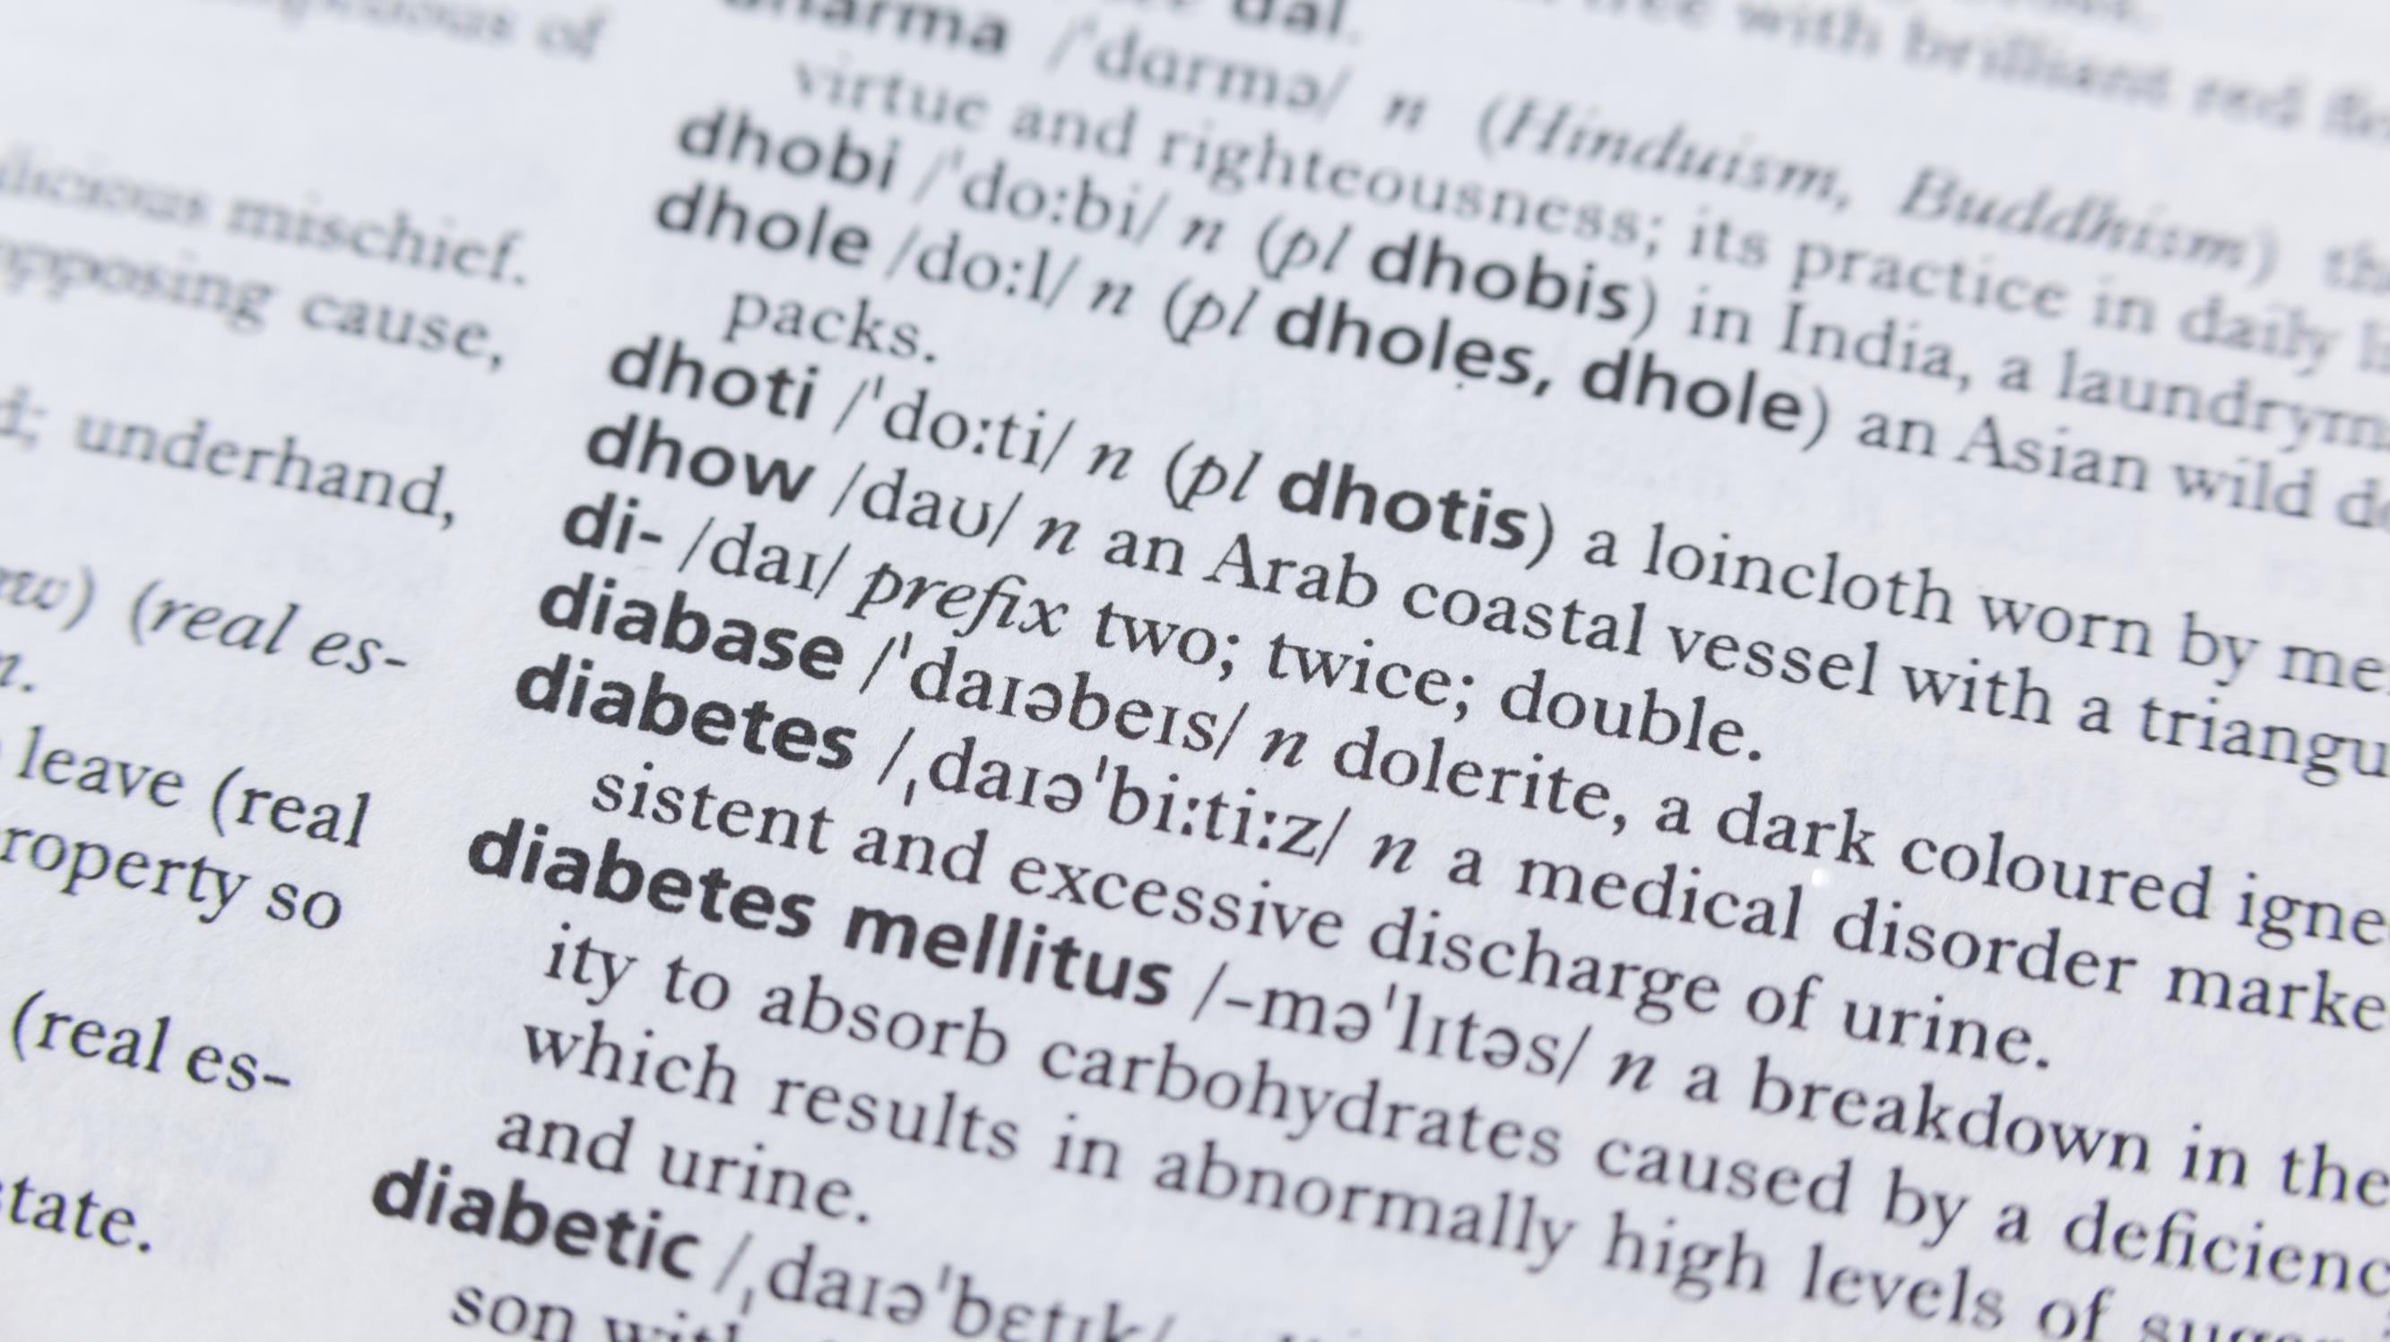





What is Diabetes?
2
Diabetes is a chronic condition that
affects how your body turns food into energy. People with diabetes have hyperglycemia, or too much sugar (glucose) in the bloodstream.
Uncontrolled, elevated glucose levels can damage tissues throughout the body, causing disease
and early death.

Slide 3



The Two Main Types of Diabetes
3
TYPE 1
(5%) The pancreas can’t make enough insulin. The immune system damages or destroys the insulin-producing cells of the pancreas. Usually starts early in life and requires lifelong insulin supplement.
Also called Juvenile Diabetes.
TYPE 2
(90-95%) The body doesn’t make enough insulin to or doesn’t use insulin well – a condition called insulin resistance.
Also called Adult Onset Diabetes.

Slide 4




Facts:
4
According to the CDC…
Diabetes is the #1 cause of kidney failure, lower limb amputations, and adult onset blindness. It can also cause heart disease, impotence, and stroke.
Other conditions closely linked to diabetes include Alzheimer’s disease, polycystic ovary syndrome, and Cushing’s syndrome.

Slide 5


What is Prediabetes?
5
Prediabetes occurs when blood sugar levels are higher than normal but not as high as they would be in diabetes.
PEOPLE WITH PREDIABETES ARE AT RISK OF DEVELOPING DIABETES.
Doctors usually diagnose prediabetes at a fasting glucose level of 100 milligrams per deciliter (mg/dl) and diabetes at 126 mg/dl.

Slide 6


Why is Prediabetes important?
6
As noted, individuals diagnosed with prediabetes face an increased likelihood of progressing to diabetes.
115 million people
– 42% of US adults – have prediabetes, which raises short-term absolute risk of Type 2 diabetes by 3- to 10-fold.¹⁻²
Overall, up to 70% of people with prediabetes may develop Type 2 diabetes during their lifetimes.³
¹ CDC, National Diabetes Statistics Report, 2017.
² Circulation. 2000 & 2005
³ Diabetes Care. 2007

Slide 7
Type 2 Diabetes Risk Factors
7
Age 45+ | Overweight or obese
Genetic predisposition | High blood pressure
Specific Ethnicities: African-American, Latino, Native American, Asian | Inactive/sedentary lifestyle
 | High cholesterol
History of gestational diabetes | History of cardiovascular disease
The average age of Lions is >60.
Are you at risk?
Source & Copyright: American Diabetes Association

Slide 8

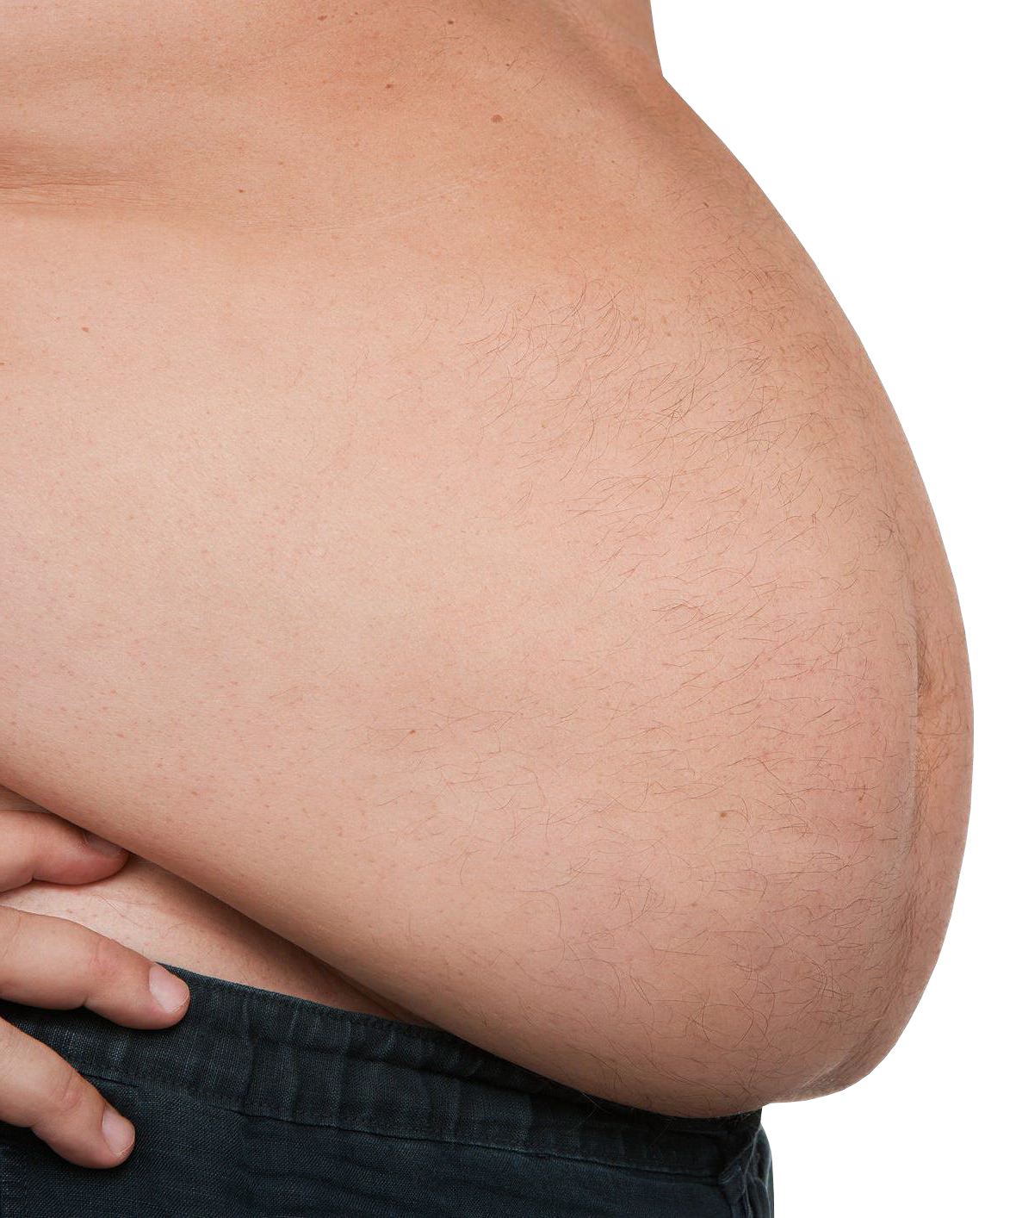

8
According to the American Diabetes Association, Type 2 diabetes is often
(but not always) tied to overweight
Obesity is
a HUGE
Factor
or obesity.
Your risk increases with weight: 12% of overweight adults and 21% of obese adults have Type 2 diabetes.*
*WebMD

Slide 9





Typical* Signs and Symptoms
of Hyperglycemia
9
Frequent Urination Increased Thirst Increased Hunger Blurry Vision Weight Loss Fatigue
Cuts or Sores That Don’t Heal
* Note that you may have hyperglycemia without obvious symptoms!

Slide 10
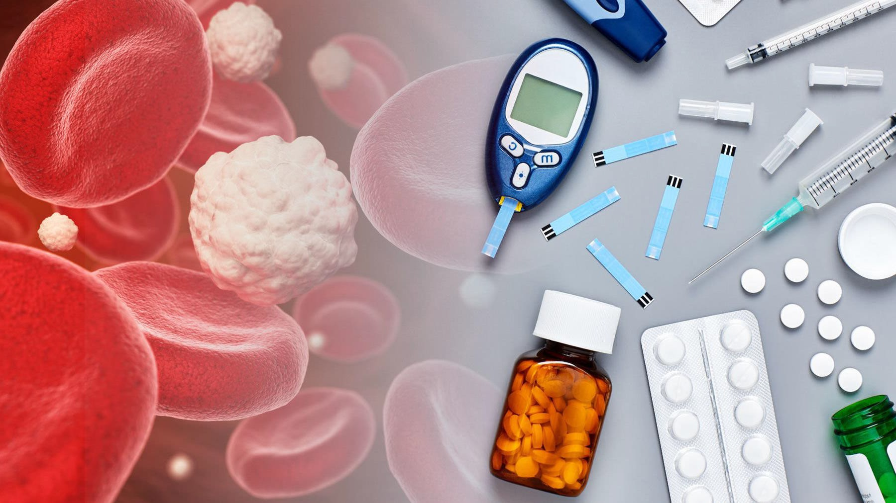


Why are Awareness & Early Diagnosis Critical?
10
Diabetes is often a “silent” disease.
It can do significant, extensive & irreversible damage to the body before you know it.
The good news is that Type 2 diabetes is reversible if you address it before major damage occurs.

Slide 11
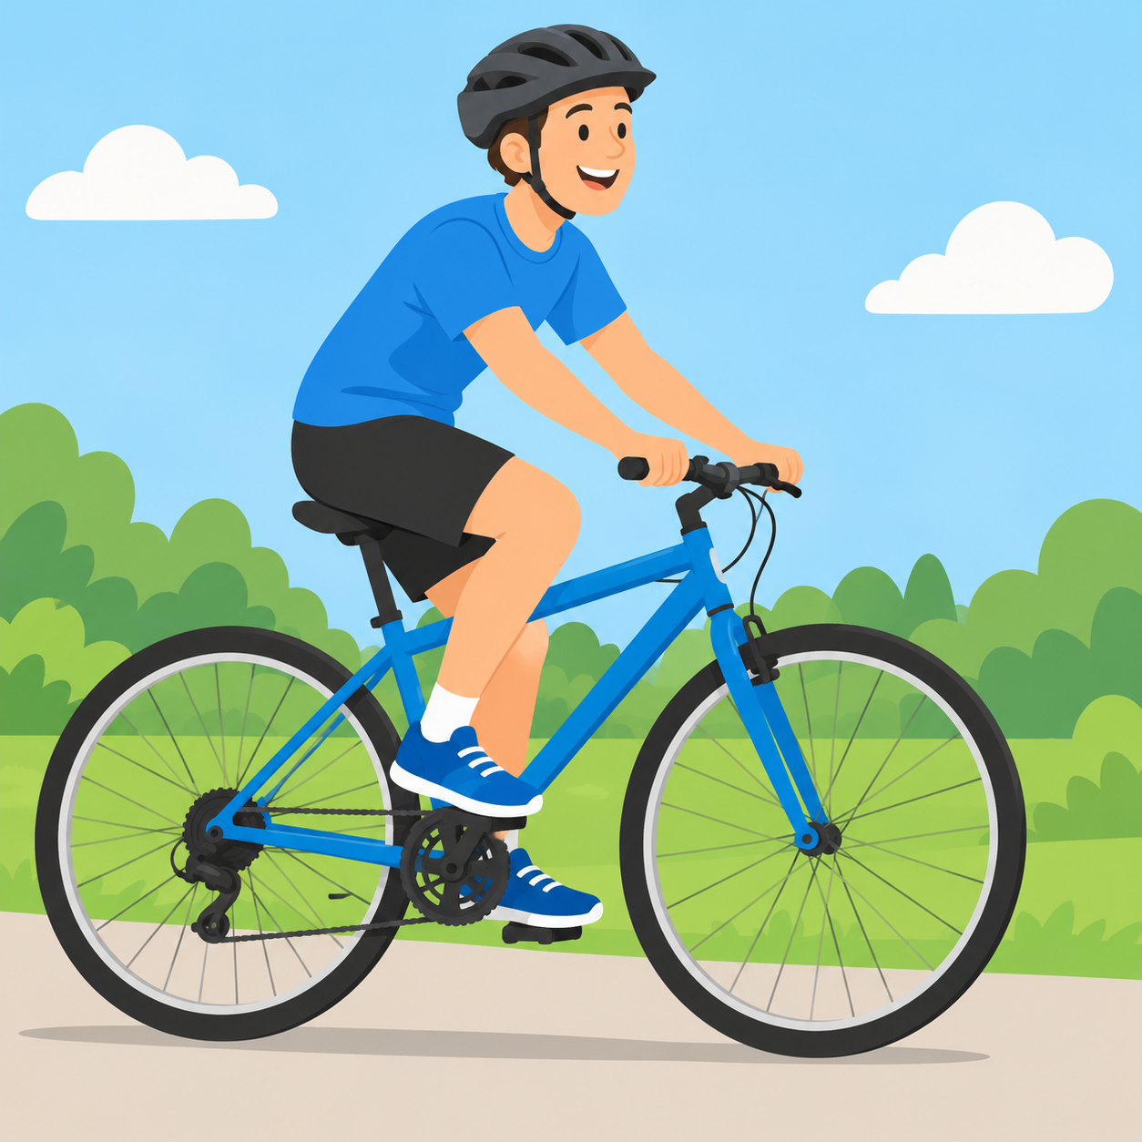



How to Prevent or Reduce Diabetes?
11
Simple lifestyle interventions can lower blood sugar and diabetes risk.
In some cases, they can forestall or even reverse diabetes.
Small changes, real results

Slide 12
Lifestyle Change Works!
12
12
58%
Lower Incidence of type 2 diabetes with 5–7% weight loss and 150+ minutes of activity a week. 71% lower for adults >60.

Slide 13



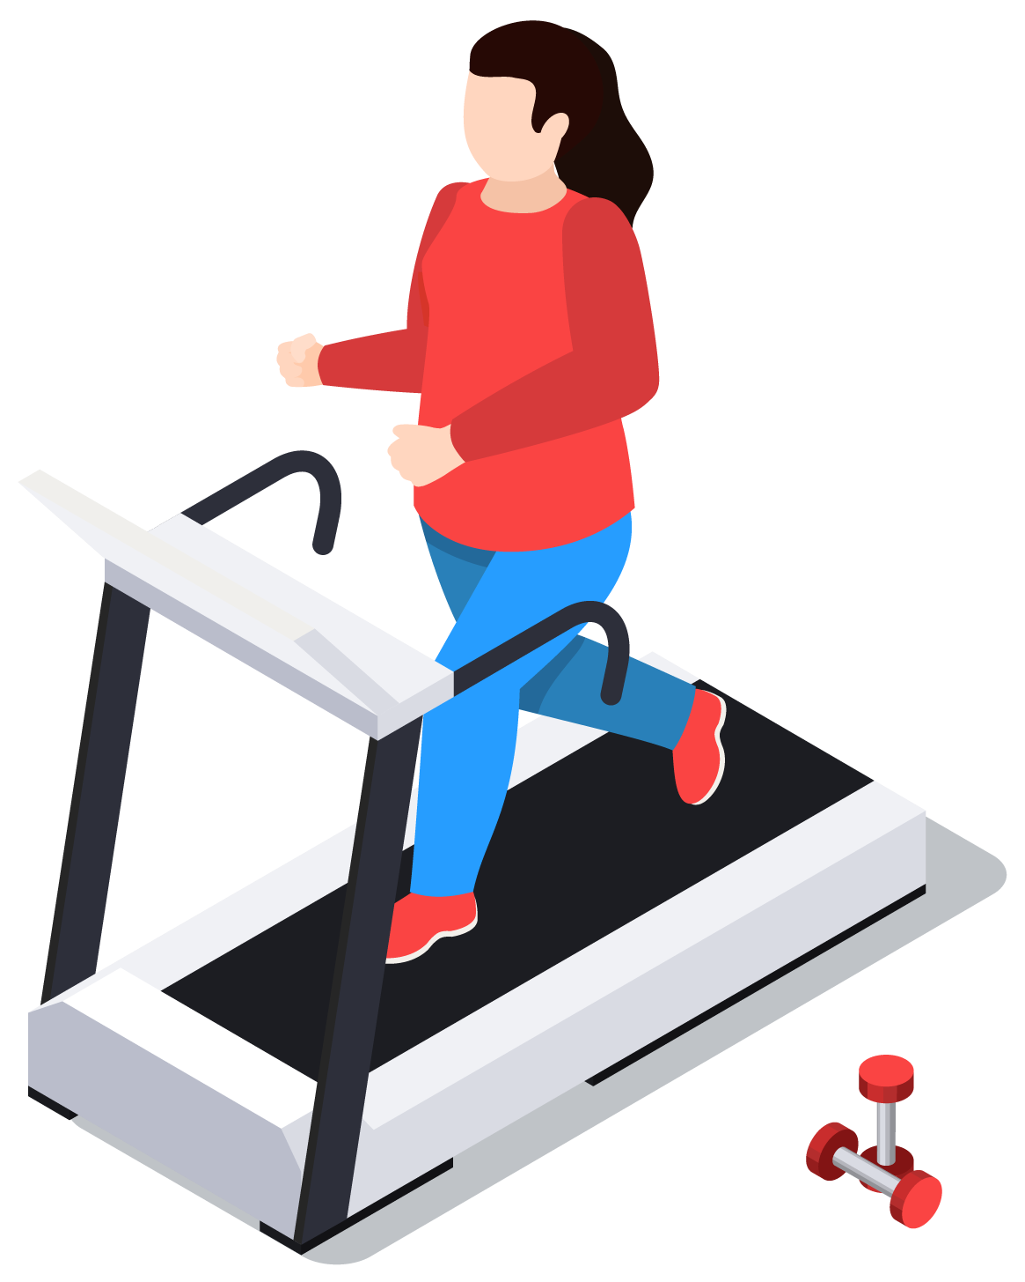
What are the Basic Lifestyle Changes / Interventions?
13
1
2
3
4
Try to lose 5-10% of your body weight.
Aim for 30 to 60 minutes of daily moderate physical activity.
Choose foods low in fat and calories and high in fiber; eat more vegetables.
Reduce your carbohydrate intake.

Slide 14



Modest Weight Loss
14
5–7%
Small numbers, big payoff
That’s about 10–14 lb for a 200-lb person
of your body weight
is the goal
Eat better + move more
Combine healthier eating with more movement

Slide 15

Be Active
15
150
30
min
30
min
30
min
30
min
30
min
minutes of moderate activity per week
Mon
Tue
Wed
Thu
Fri
Brisk walking counts: 30 minutes, 5 days a week
Break up long stretches of sitting
Stand, stretch or take a short walk every 30 minutes

Slide 16



Eat for Steady Blood Sugar
16
Fill half the plate with vegetables
Greens, broccoli, peppers, carrots
¼
Protein
Choose whole grains and fiber
Oats, brown rice, beans, whole-wheat bread
½
Vegetables
¼
Grains
Swap sugary drinks for water
Or unsweetened tea, coffee or sparkling water
The Diabetes Plate Method

Slide 17
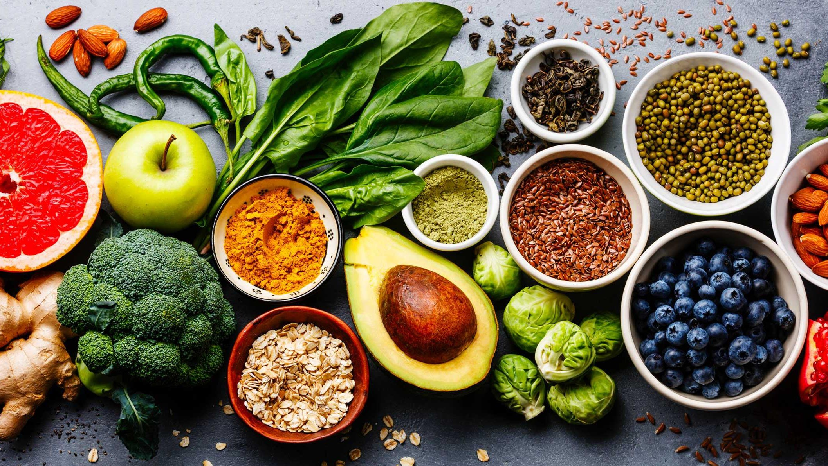

Dietary Patterns & Health Benefits
17
Health Benefits* | Reduced Risk of Diabetes | A1C Reduction | Reduced Risk of Heart Disease (CVD) | Weight Loss | Lowered Blood Pressure
Mediterranean Diet
Vegetarian & Vegan Diets
Low-Carb & Very Low-Carb Diets
Low-fat Diet
Very Low-fat Diet
DASH Diet (Dietary Approach to Stop Hypertension)
Paleo Diet | Mixed Results. Inconclusive evidence.
Source: Random Clinical Trials (RCTs), Meta-Analyses, Observational Studies, non-randomized single-arm studies, cohort studies.
Nutrition Therapy for Adults With Diabetes or Prediabetes: A Consensus Report
Evert et al, Diabetes Care Apr. 2019

Slide 18

Intermittent Fasting (IF) to Lose Weight*
18
Popular Approaches:
TIME-RESTRICTED FEEDING
Restrict daily eating to a 6-8 hour window with no calories outside of the window.
WEEKLY IF REGIMENS
“Alternate-day fasting” and “5-2 Fasting”(eat 5 days, fast 2)
*New England Journal of Medicine, Effects of Intermittent Fasting of Health, Aging and Disease, Dec. 26, 2019.

Slide 19

Caveats
re: Intermittent Fasting (IF)
19
It’s not for everyone. Consult with your primary care provider before starting any dietary intervention, especially IF.
Studies are lacking on the immediate to long-term effects of IF, and risks are not fully known.
Because of the unknowns, the American Diabetes Association and Emory’s Global Diabetes Research Center (EGDRC) are not recommending IF. Instead, both recommend a gradual change in diet and increase in exercise.

Slide 20




Helpful Tools for Weight Control & Metabolic Feedback
20
Electronic scale
Portion plate
Smartwatch

Slide 21



Other Healthy Habits That Help
21
Manage stress
Get regular sleep
Avoid tobacco & limit alcohol
Plan for obstacles and solve problems as they arise
Aim for 7 or more hours a night on a steady schedule
Smokers are 30–40% more likely to develop type 2 diabetes

Slide 22

You can Make a Difference
22
– in your Health
Adopting simple lifestyle changes now may help you to:
1
Live a longer & healthier life
2
Avoid diabetes or prediabetes altogether
3
Treat your prediabetes or diabetes;
even reverse it!
4
Reduce future medical & insurance expenses

Slide 23
For More Information and Resources:
Lions Diabetes Website:
http://diabetes-partners.org
Jon Yaeger lionjonyaeger@gmail.com
(404) 610-9386 (cell)
ALSO

