Slide 1



Type 2
DIABETES
The Largest Pandemic in Human History
?
A Lions call to action

Slide 2
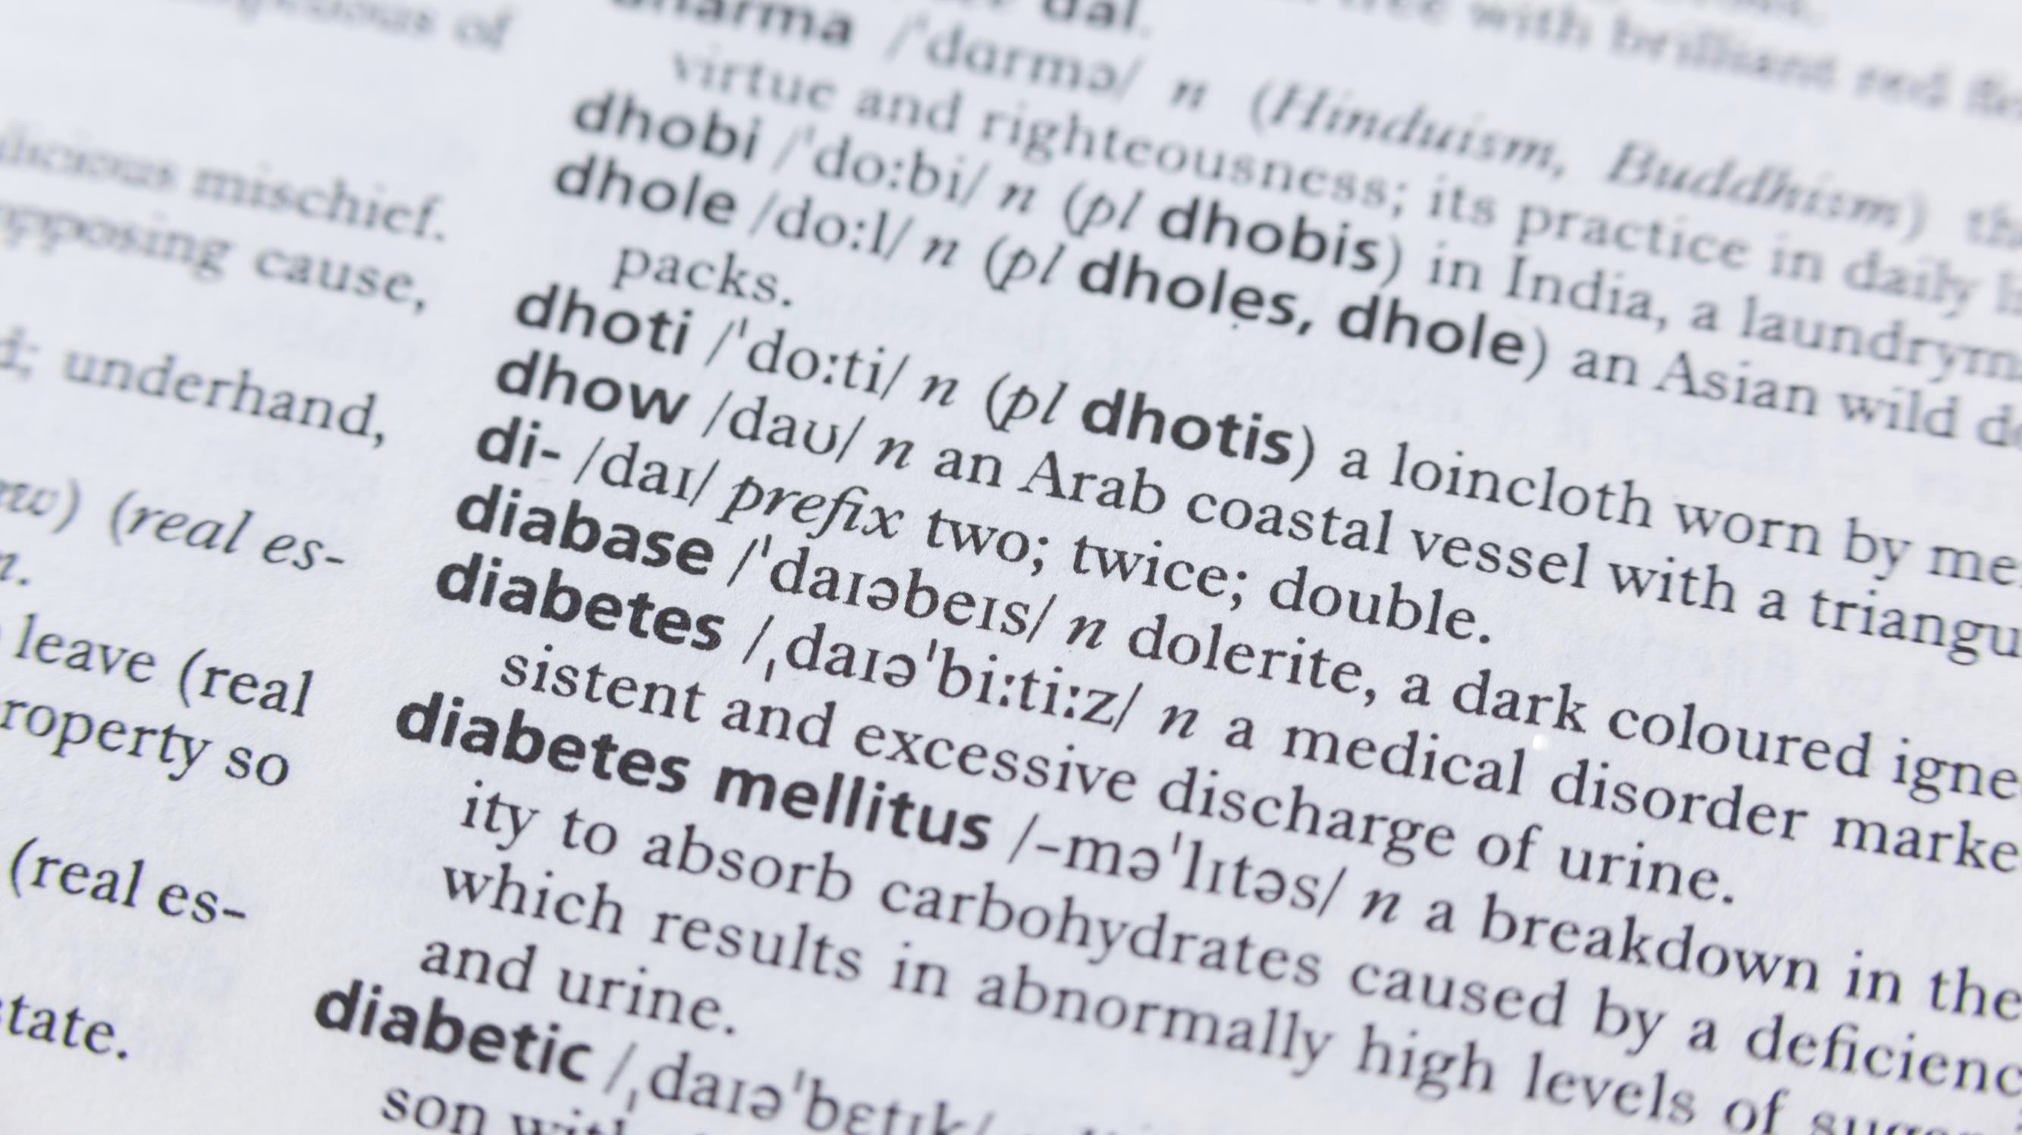




What is Diabetes?
Diabetes is a chronic condition that
affects how your body turns food into energy. People with diabetes have hyperglycemia, or too much sugar (glucose) in the bloodstream.
Uncontrolled, elevated glucose levels can damage tissues throughout the body, causing disease
and early death.

Slide 3



What is Prediabetes?
Prediabetes occurs when blood sugar levels are higher than normal but not as high as they would be in diabetes. DIABETES.

Slide 4


Why is Prediabetes important?
Individuals diagnosed with prediabetes face an increased likelihood of progressing to diabetes.
115 million people
– 42% of US adults – have prediabetes, which raises short-term absolute risk of Type 2 diabetes by 3- to 10-fold.¹⁻²
Overall, up to 70% of people with prediabetes may develop Type 2 diabetes during their lifetimes.³
¹ CDC, National Diabetes Statistics Report, 2017.
² Circulation. 2000 & 2005
³ Diabetes Care. 2007

Slide 5


The Two Main Types of Diabetes
(Diabetes is now understood to have multiple subgroups)
TYPE 1
(5%) The pancreas makes too little or no insulin, usually because the immune system attacks and destroys its insulin-producing cells.
Typically manifests early in life and requires lifelong insulin supplementation.
TYPE 2
(90-95%) The body fails to use insulin properly (a condition called insulin resistance) and the pancreas cannot compensate.

Slide 6



The Prognosis:
TYPE 1
Type 1 diabetes has no cure, but it can be controlled.
TYPE 2
Type 2 diabetes has no cure, but it can be controlled.
Sometimes it may go into remission.
Lions
Lions
have a role with both diabetes types!

Slide 7



Medical Impact
According to the CDC…
Diabetes is the #1 cause of kidney failure, lower limb amputations, and adult onset blindness. It can also cause heart disease, impotence, and stroke.
Other conditions closely linked to diabetes include Alzheimer’s disease, polycystic ovary syndrome, and Cushing’s syndrome.

Slide 8
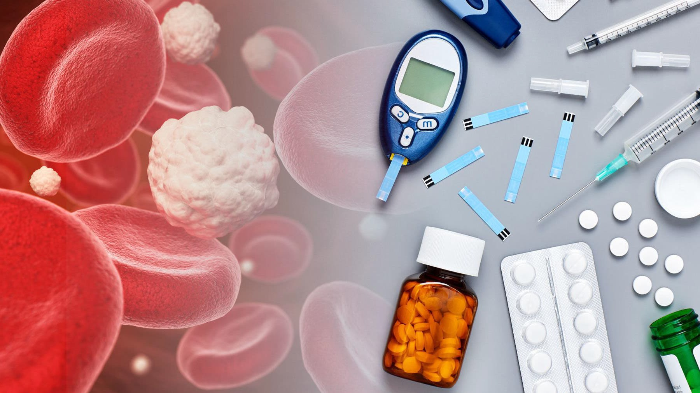


Why are Awareness & Early Diagnosis Critical?
Diabetes is often a “silent” disease.
It can do significant, extensive & irreversible damage to the body before you know it.
Lions can build public awareness and conduct screenings (hopefully) before damage occurs.

Slide 9

People with these Risk Factors are more likely to develop diabetes (our “target” audience):
Age 45+ | Overweight or obese
Genetic predisposition | High blood pressure
Specific Ethnicities: African-American, Latino, Native American, Asian | Inactive/sedentary lifestyle
 | High cholesterol
History of gestational diabetes | History of cardiovascular disease

Slide 10

Typical* Signs and Symptoms of Hyperglycemia
* Important: The danger is that hyperglycemia patients often have no obvious symptoms!
Frequent Urination
Increased Thirst
Increased Hunger
Blurry Vision
Weight Loss
Fatigue
Cuts or Sores That Don’t Heal

Slide 11
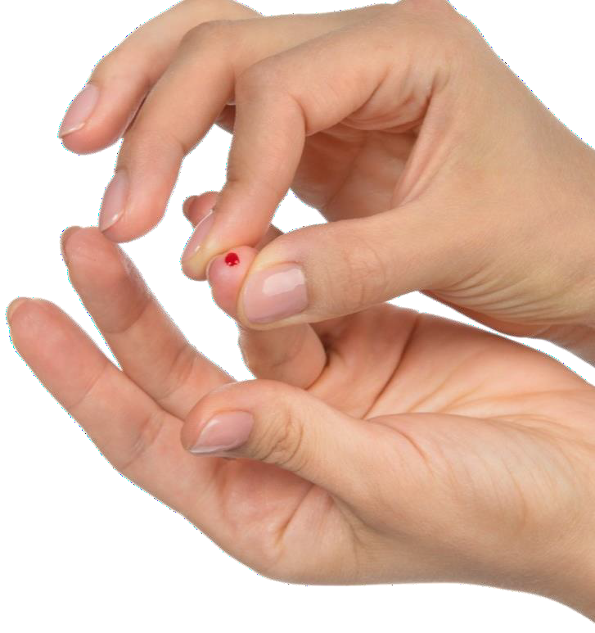


Facts (for Georgia):
>80
%
of the 2.6 million people with
high blood sugar (hyperglycemia)
don’t know it
%
of Georgians with
Type 2 Diabetes are
undiagnosed (estimates
range from 63 – 234 thousand)
20
Our “TARGET AUDIENCE” for diabetes awareness and screening exceeds 2 MILLION Georgians!

Slide 12








Financial Burden of Diabetes in Georgia
$13.3B Total
Updated 2022
$9.9 billion for direct medical costs
$3.4 billion reduced productivity
Medical expenditures among people with diagnosed diabetes were 2.6 times higher than for those without
Sources: CDC & American Diabetes Ass’n

Slide 13

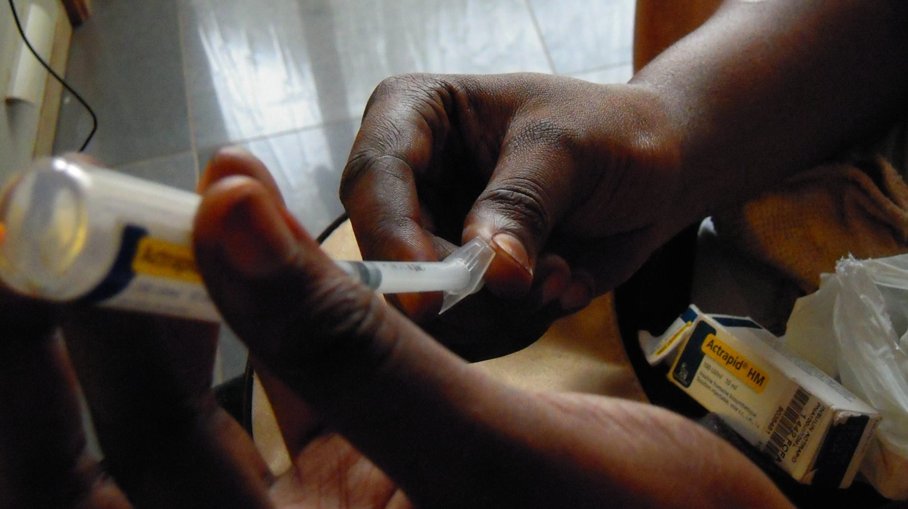

Care for a person with diabetes costs an
average of
$19,736
per year¹
¹ 2022 statistics from diabetesjournals.org

Slide 14


Calling All Lions !
• Action Items •
What can Lions do to help to prevent and lessen the burden of diabetes in our communities?
Educate yourself & your club about diabetes.
Download and share info & resources from the Lions 18-I diabetes website
Conduct 1 minute diabetes / prediabetes screening tests
Hold a blood screening event
Obtain a Lions International grant for a diabetes initiative
Sponsor a Strides™ fundraising campaign
Support Camp Kudzu (catering to children with type 1 diabetes)

Slide 15
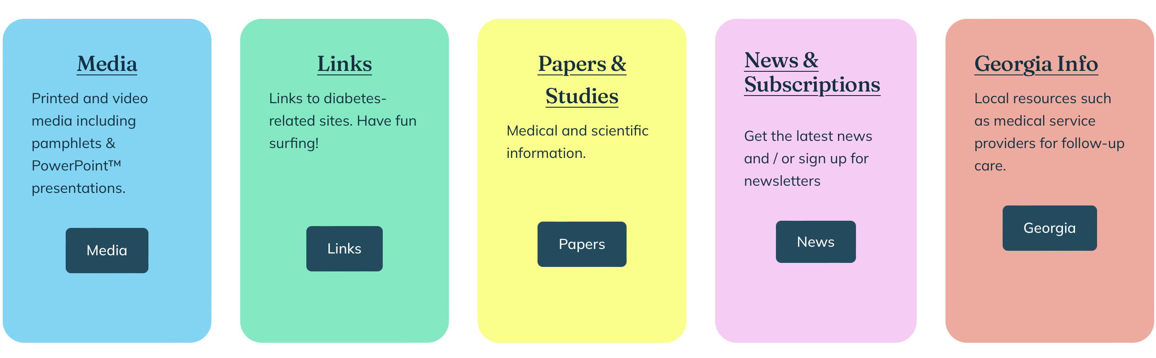

Download & Distribute Diabetes Info and Resources from the District 18- I Diabetes Website: https://diabetes-partners.org
Diabetes Resources:

Slide 16
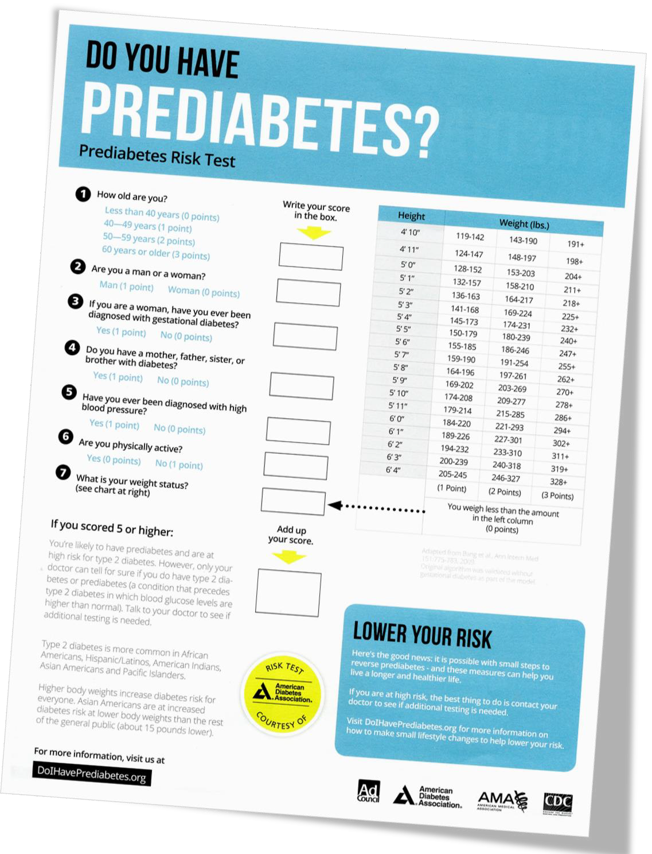


1 MINUTE
Prediabetes Risk Test
Simple Screening
Administer the
Courtesy of the American Diabetes Association

Slide 17
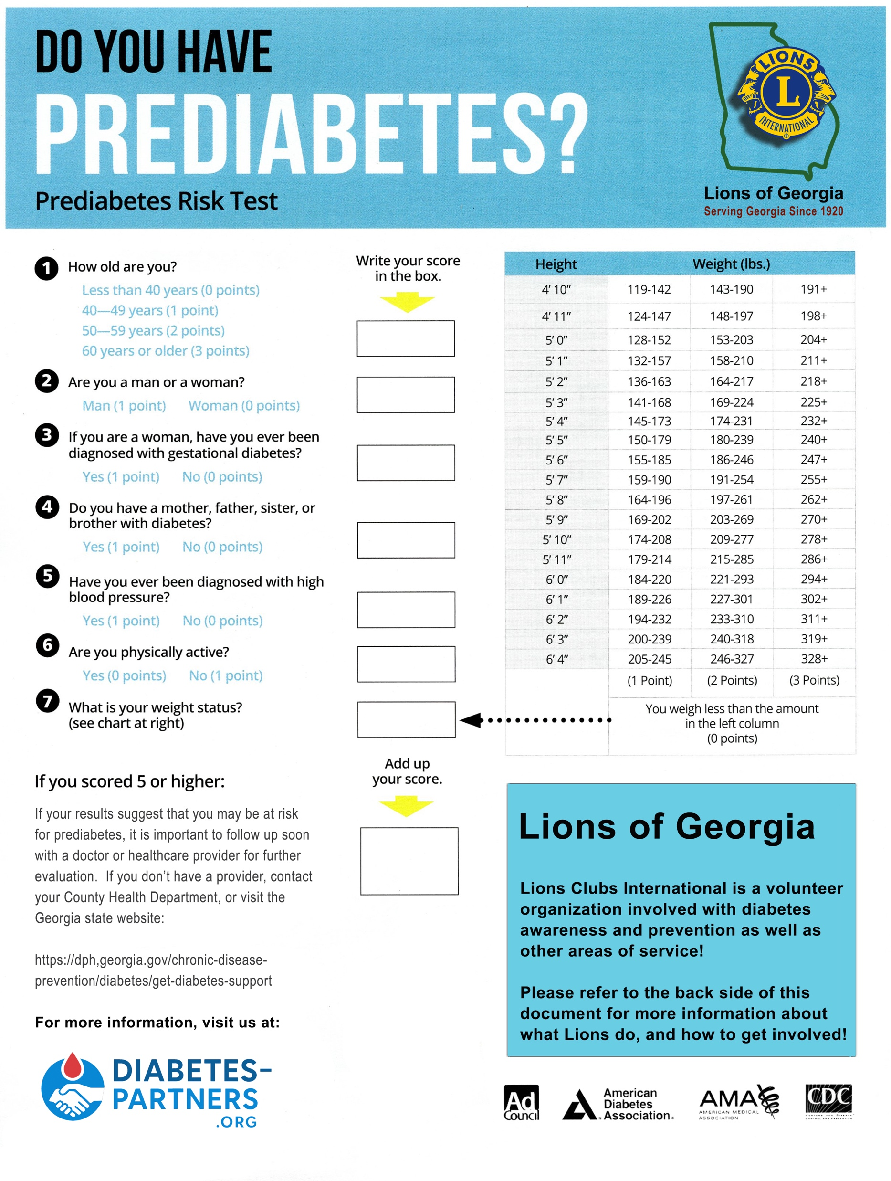
Modified to highlight Lions.
Administer the
Lions

Slide 18

Put your contact info here
Administer the
Printed Avery™ type
labels work best

Slide 19

The Risk Test is a Lions Membership Tool!
Lions info is printed on the back side of the form, with room for your club’s contact label.
Use the event to:
• Talk about what Lions do
• Invite folks to your club
• Offer to screen other groups they know

Slide 20
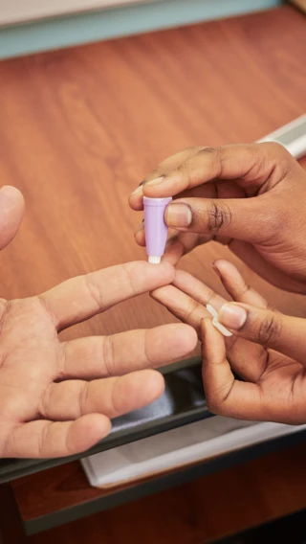
Blood Glucose Screening
• More accurate, but more difficult to do
• Requires a healthcare pro
• Must follow LCIF guidelines (LCIF grants available)
See the diabetes-partners.org website
for more information.

Slide 21
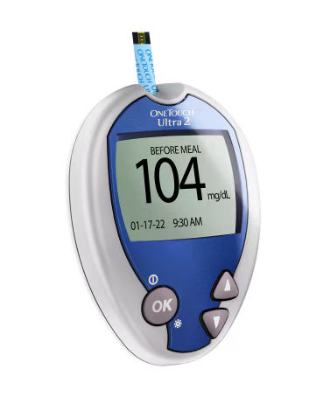
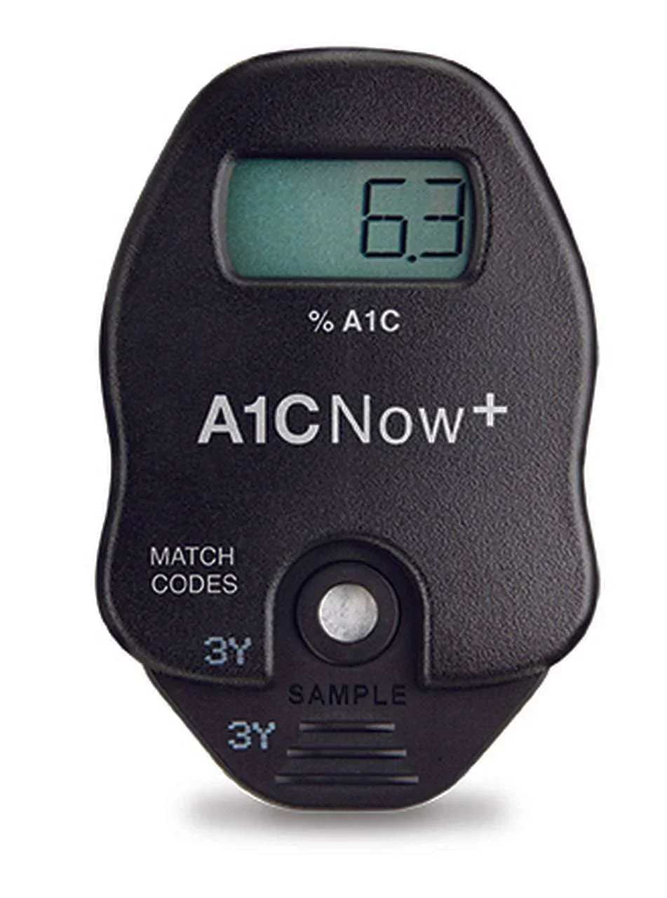
Blood Glucose Measurement Methods
Random fasting glucose
Hba1C (glycated hemoglobin)
• Avg. 2-3 month levels
• More accurate
• More expensive
• Single point in time
• Quick results
• Inexpensive
Normal range: 70 to 99 mg/dL
Prediabetes: 100 to 125 mg/dL
Diabetes: > 125 mg/dL
Normal range: < 5.7%
Prediabetes: 5.7 – 6.4%
Diabetes: ≥ 6.5

Slide 22
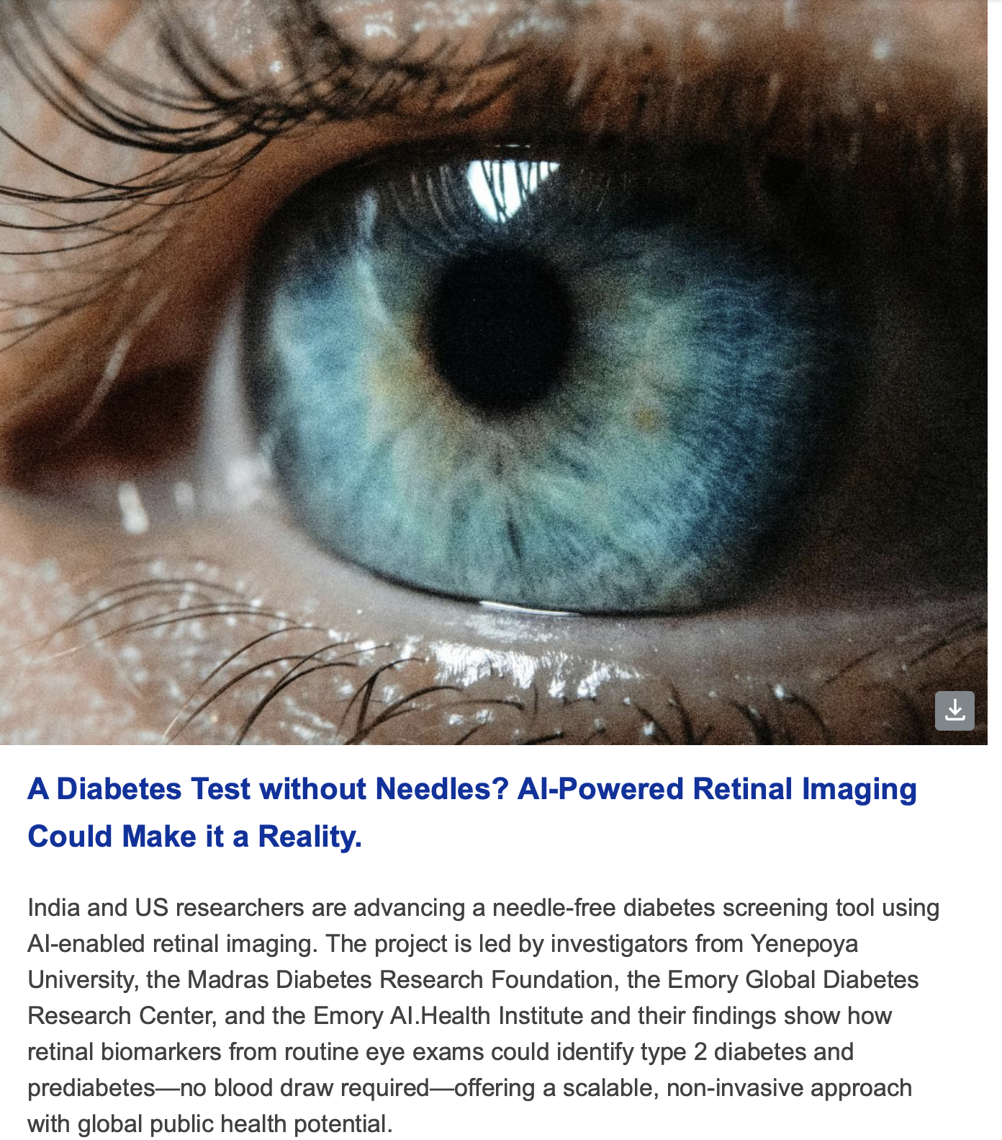
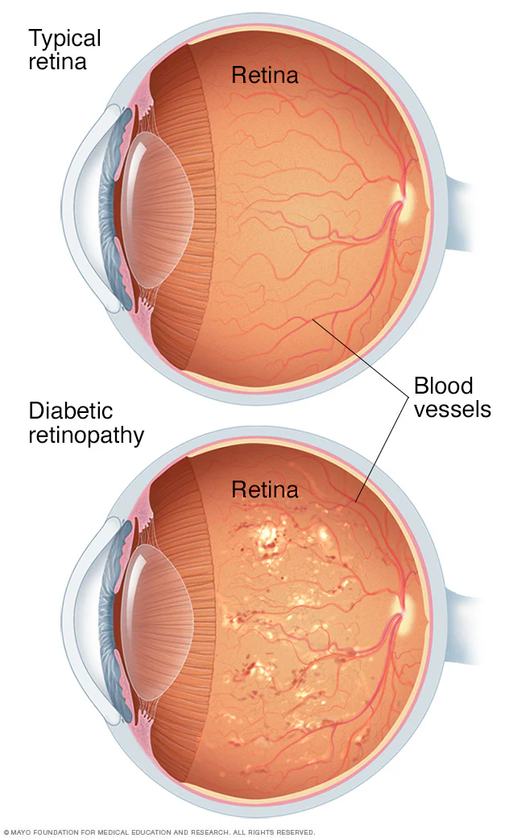
Coming: Retinal Screening without Dilation
Diabetic retinopathy and CV disease discoverable with an iPhone & A.I.
Preliminary findings:
95% sensitivity
75% specificity

Slide 23

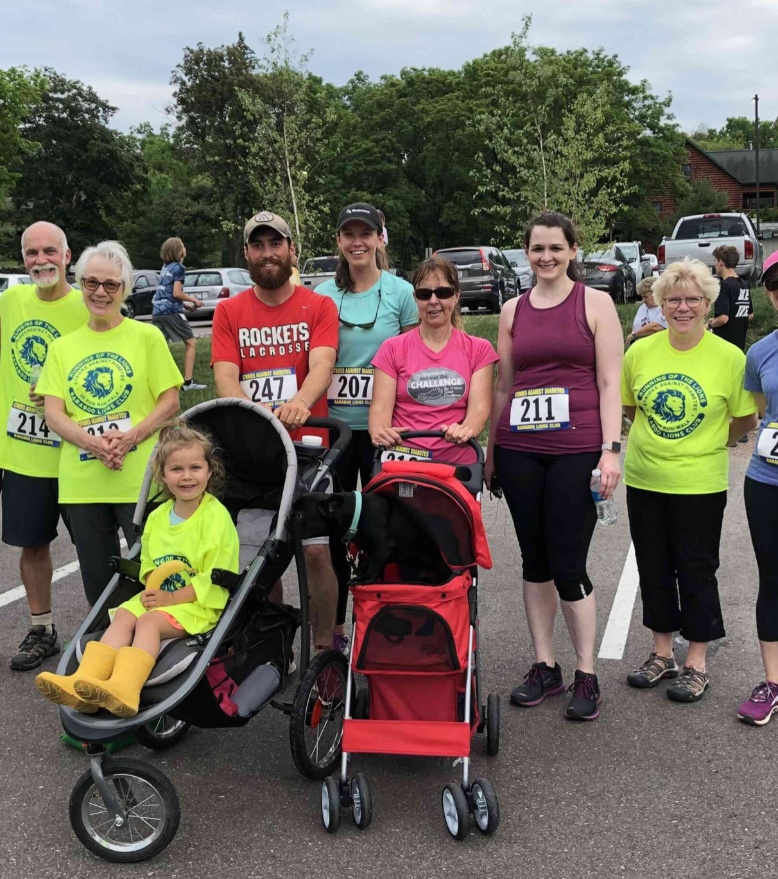
Strides for Diabetes Awareness
Lions & Leos can promote Diabetes
Awareness with a Strides event that can double as a fundraiser. Sample events:
• 5K/1-mile runs or walks
• Mall walking
• Screening & education fairs
• Dance events

Slide 24


Donate to Camp Kudzu
Help a child with Type 1 diabetes to attend this special camp for diabetic kids.

Slide 25

For More Information and Resources
Visit the Georgia Lions District 18-I
Diabetes Website:
http://diabetes-partners.org/
Jon Yaeger jonathan.yaeger@gmail.com
(404) 610-9386 (cell)
Contact

