Slide 1



Type 2 DIABETES
The Largest Pandemic in Human History
?
A Lions call to action

Slide 2
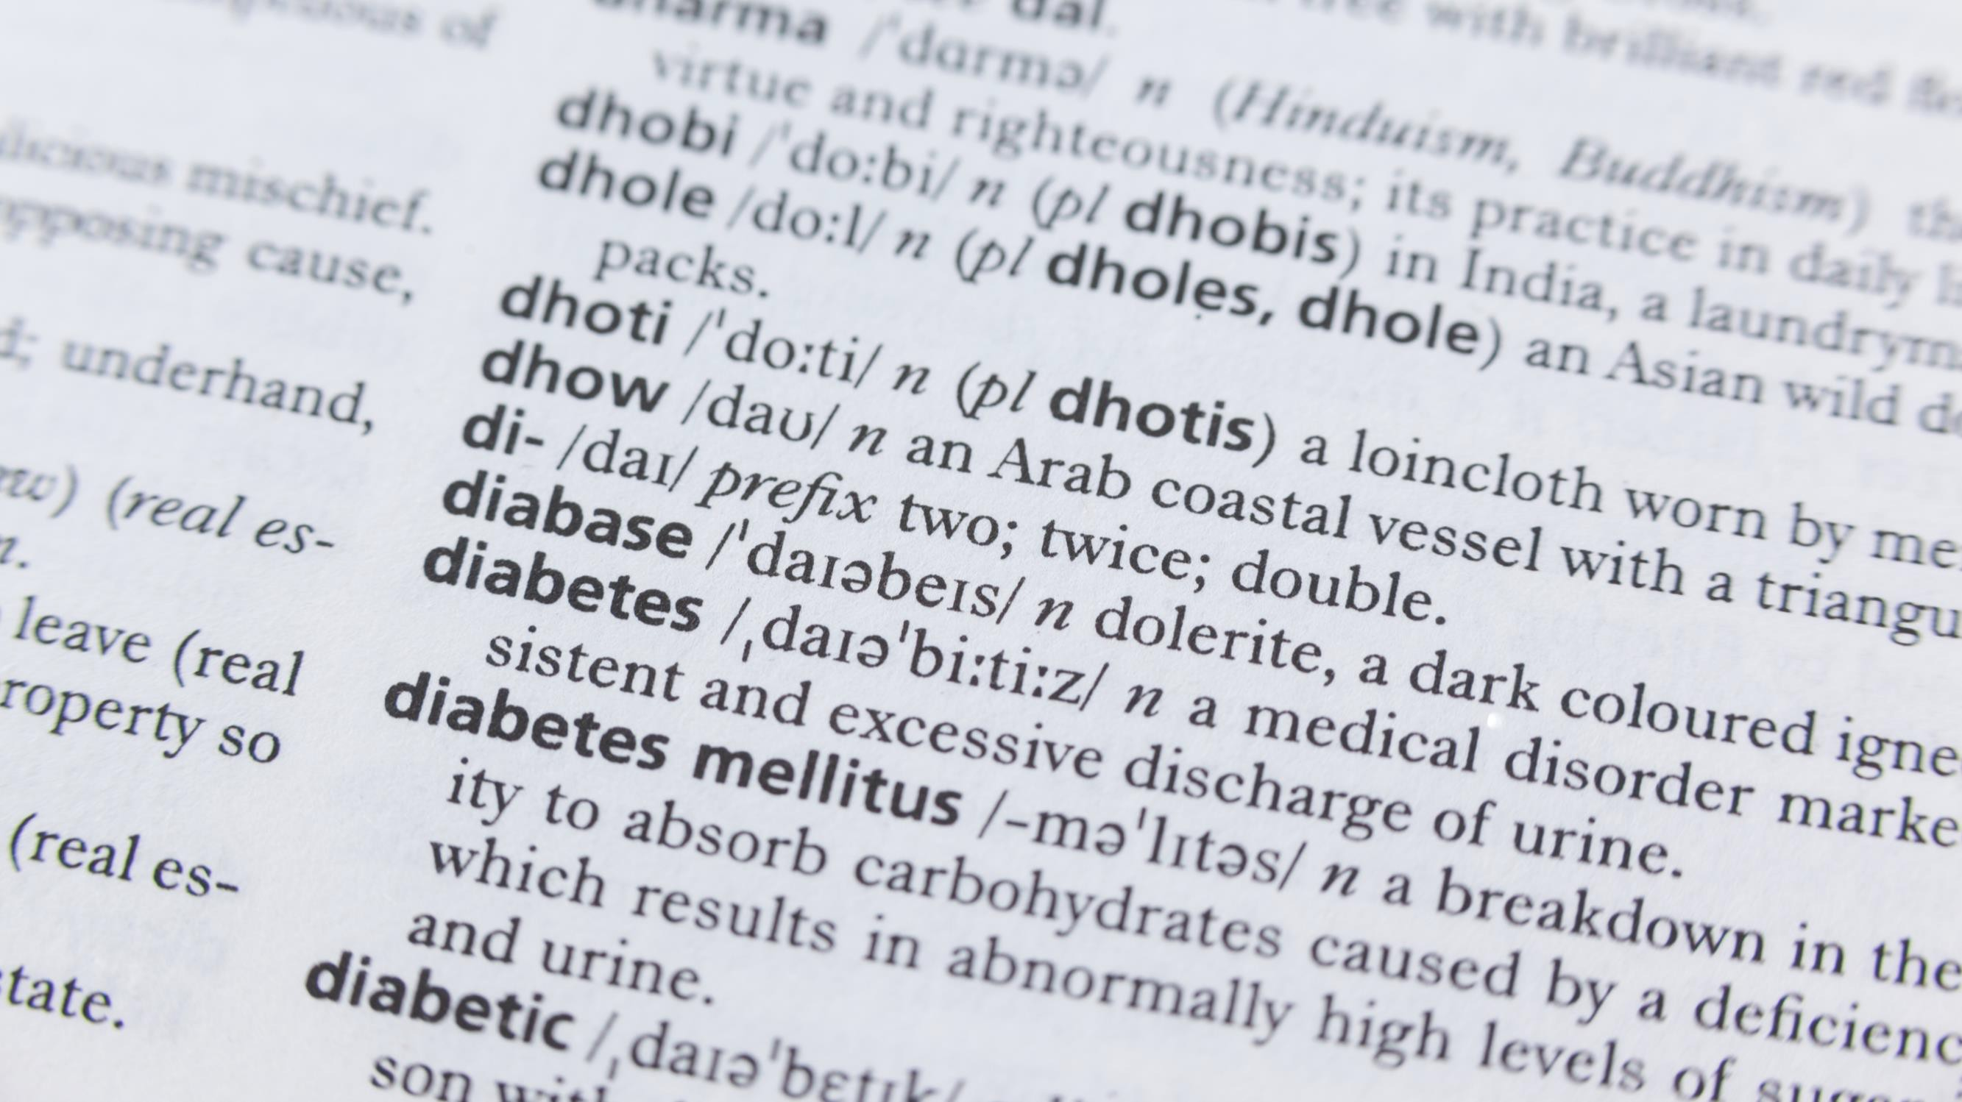





What is Diabetes?
Diabetes is a chronic condition that
affects how your body turns food into energy. People with diabetes have hyperglycemia, or too much sugar (glucose) in the bloodstream.
Uncontrolled, elevated glucose levels can damage tissues throughout the body, causing disease
and early death.

Slide 3



The Two Main Types of Diabetes
TYPE 1
(5%) The pancreas produces an insufficient amount of insulin.
The immune system damages or destroys the insulin-producing cells of the pancreas. Usually manifests early in life and requires lifelong insulin supplement.
TYPE 2
(90-95%) The body doesn’t make enough insulin to handle excess glucose or doesn’t use insulin well – a condition called insulin resistance.

Slide 4

Living with Diabetes
TYPE 1
Type 1 diabetes has no cure, but it can be controlled with insulin.
TYPE 2
Type 2 diabetes has no cure, but it can be controlled with medication and lifestyle changes. Sometimes it may go into remission.

Slide 5



Typical* Signs and Symptoms
of Diabetes
Frequent Urination Increased Thirst Increased Hunger Blurry Vision Weight Loss Fatigue
Cuts or Sores That Don’t Heal
* Note: You can have diabetes
without obvious symptoms !

Slide 6
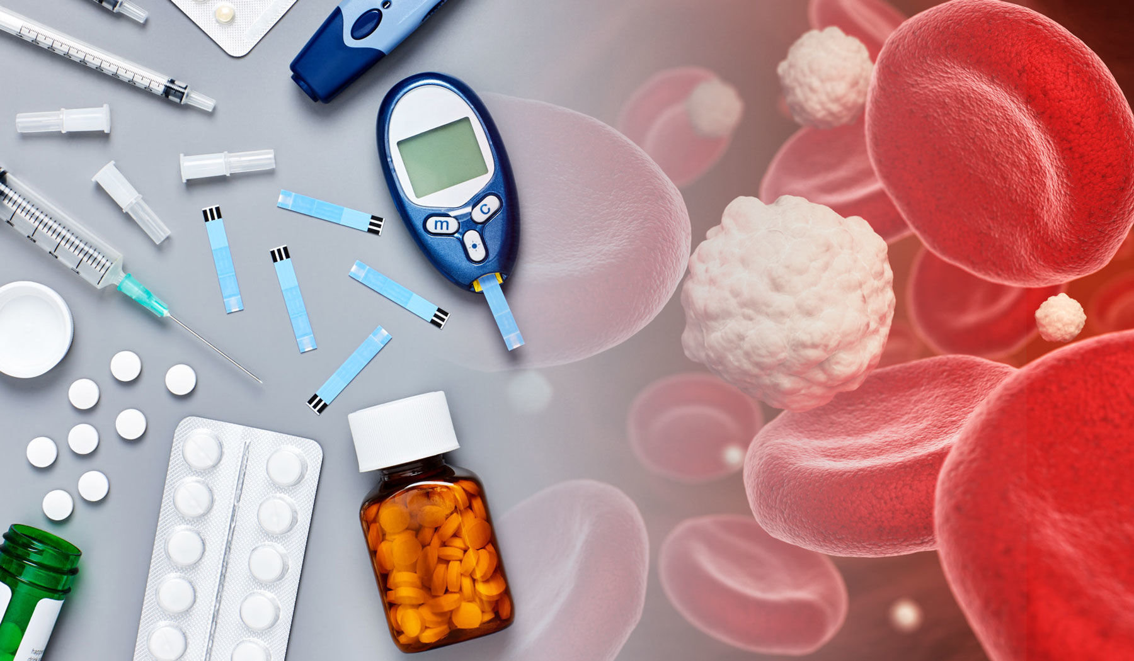
Why are Awareness & Early Diagnosis Critical?
Diabetes is often a “silent” disease.
It can do significant, extensive & irreversible damage to the body before you know it.
The good news is that Type 2 diabetes is reversible if you address it before major damage occurs.

Slide 7

Facts:
According to the CDC…
Diabetes is the #1 cause of kidney failure, lower limb amputations, and adult onset blindness. It can also cause heart disease, impotence, and stroke.
Other conditions closely linked to diabetes include Alzheimer’s disease, polycystic ovary syndrome, and Cushing’s syndrome.

Slide 8


What is Prediabetes?
Prediabetes occurs when blood sugar levels are higher than normal but not as high as they would be in diabetes. DIABETES.

Slide 9


Why is Prediabetes important?
Individuals diagnosed with prediabetes face an increased likelihood of progressing to diabetes.
115 million people
– 42% of US adults – have prediabetes, which raises short-term absolute risk of Type 2 diabetes by 3- to 10-fold.¹⁻²
Overall, up to 70% of people with prediabetes may develop Type 2 diabetes during their lifetimes.³
¹ CDC, National Diabetes Statistics Report, 2017.
² Circulation. 2000 & 2005
³ Diabetes Care. 2007

Slide 10
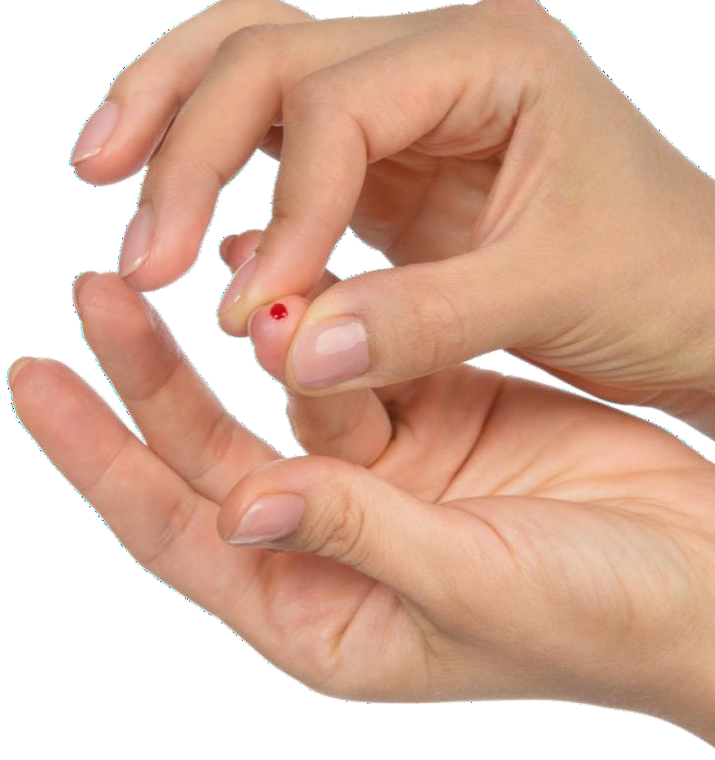


Facts (for the USA):
>80
%
of the 155 million people with
high blood sugar (hyperglycemia)
don’t know it
27.6
%
of people with
Type 2 Diabetes
are yet undiagnosed¹
%
12
38.4 million Americans have diabetes – and 1.1 million (12.1%) in Georgia²
At current trends, over
100 million in the U.S. will have diabetes by 2050!
¹ CDC – 2023 data
² The American Diabetes Association

Slide 11

Our Lions & Leos Mission:
Raise public awareness and get people screened for high blood sugar before diabetes and organ damage can occur.

Slide 12

People with these Risk Factors are more likely to develop diabetes (our “target” audience):
Age 45+ | Overweight or obese
Genetic predisposition | High blood pressure
Specific Ethnicities: African-American, Latino, Native American, Asian | Inactive/sedentary lifestyle
 | High cholesterol
History of gestational diabetes | History of cardiovascular disease

Slide 13


Calling All Lions !
• Action Items •
What can Lions do to help to prevent and lessen the burden of diabetes in our communities?
Educate yourself & your club about diabetes.
Download and share info & resources from the Lions 18-I diabetes website
Conduct 1 minute diabetes / prediabetes screening tests
Hold a blood screening event
Obtain a Lions International grant for a diabetes initiative
Sponsor a Strides™ fundraising campaign
Support Camp Kudzu (catering to children with type 1 diabetes)

Slide 14
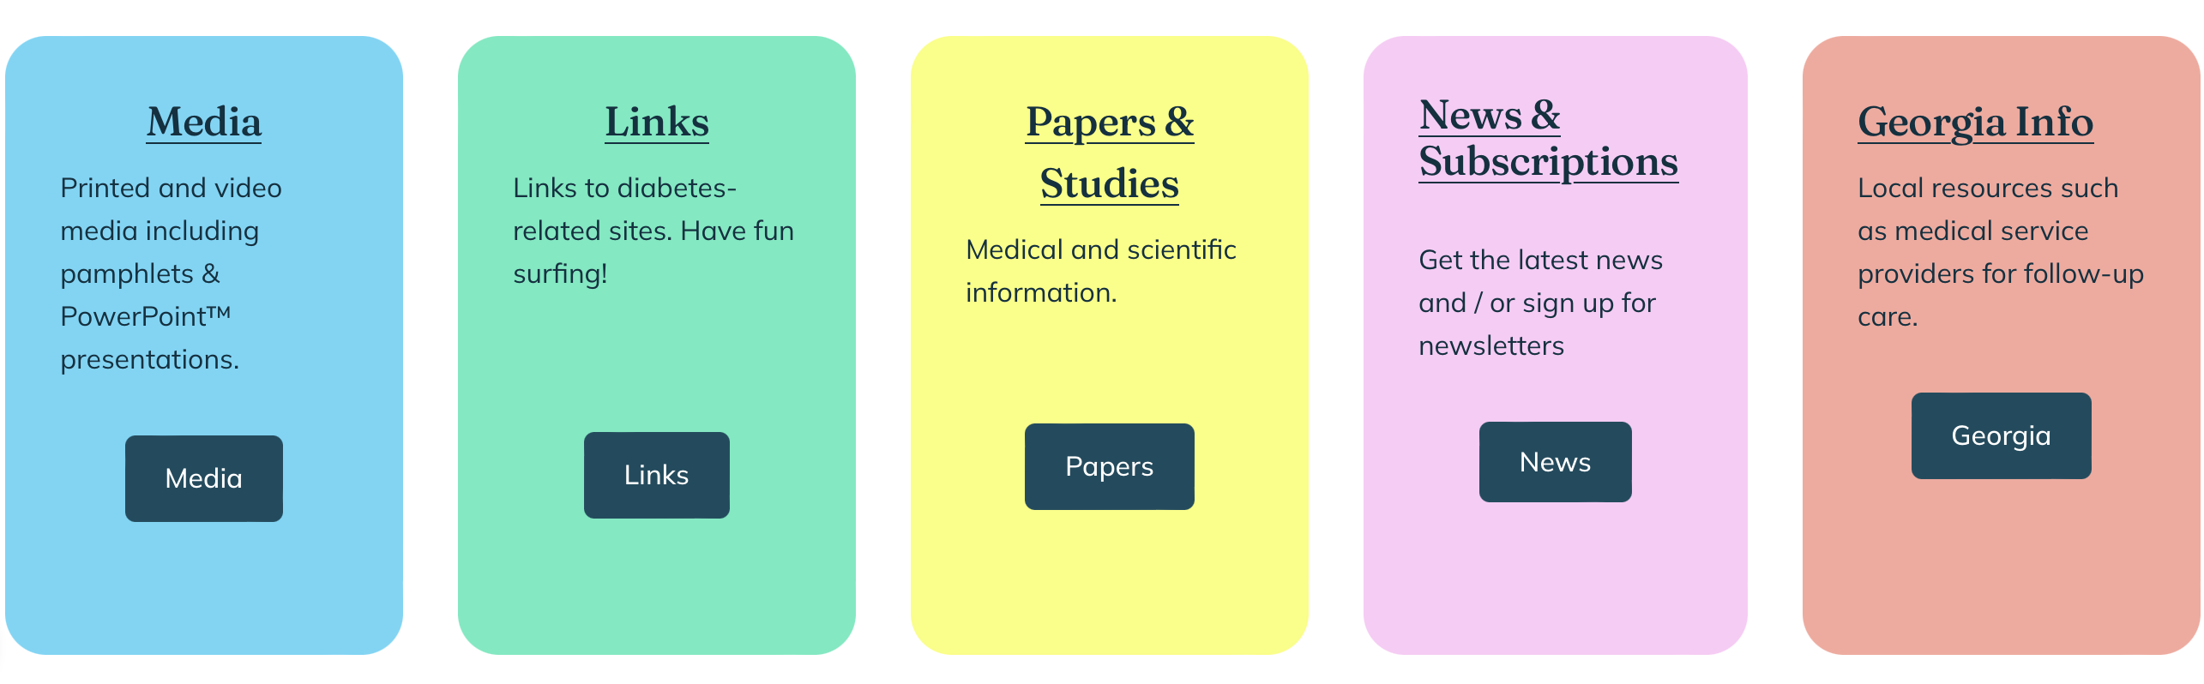
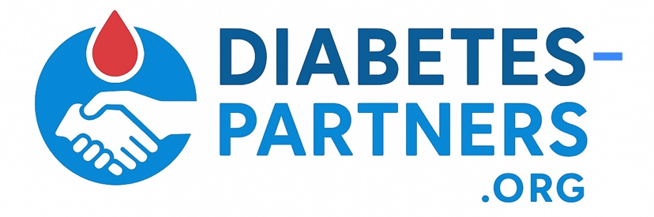
Download & Distribute Diabetes Info and Resources from the District 18- I Diabetes Website: https://diabetes-partners.org
Diabetes Resources:

Slide 15
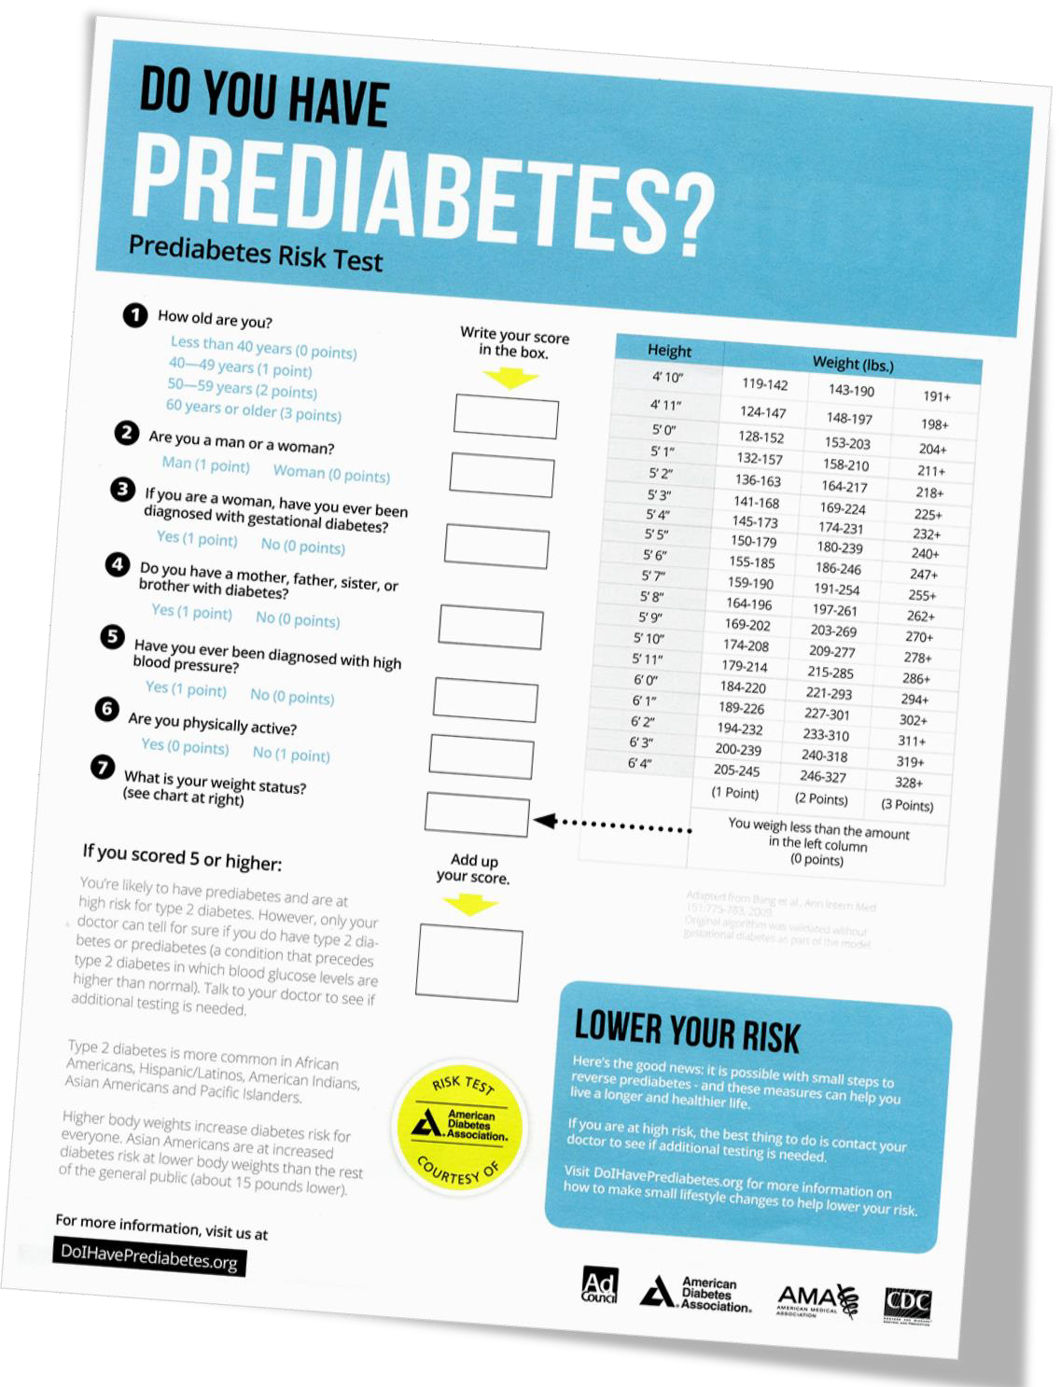

1 MINUTE
Prediabetes Risk Test
Simple Screening
Administer the
Courtesy of the American Diabetes Association

Slide 16

The Risk Test is a Lions Membership Tool!
Lions info is printed on the back side of the form, with room for your club’s contact label.
Use the event to:
• Talk about what Lions do
• Invite folks to your club
• Offer to screen other groups they know

Slide 17
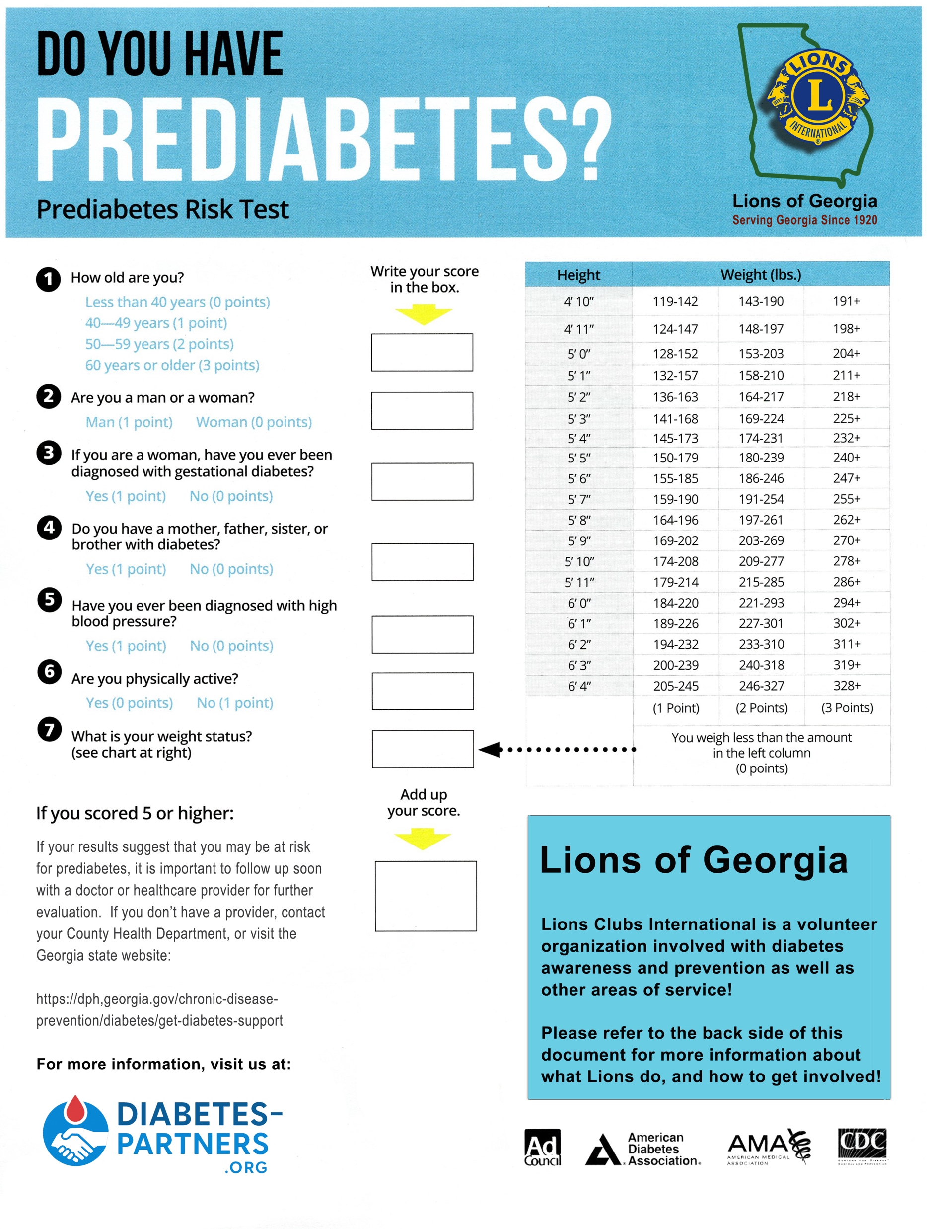
Modified to highlight Lions.
Administer the
Lions

Slide 18

Put your contact info here
Administer the
Printed Avery™ type
labels work best

Slide 19
Please consider deploying risk tests at:
• Places of Worship
• Lions eye screening events
• Businesses
• Public & private functions
• Schools & colleges

Slide 20

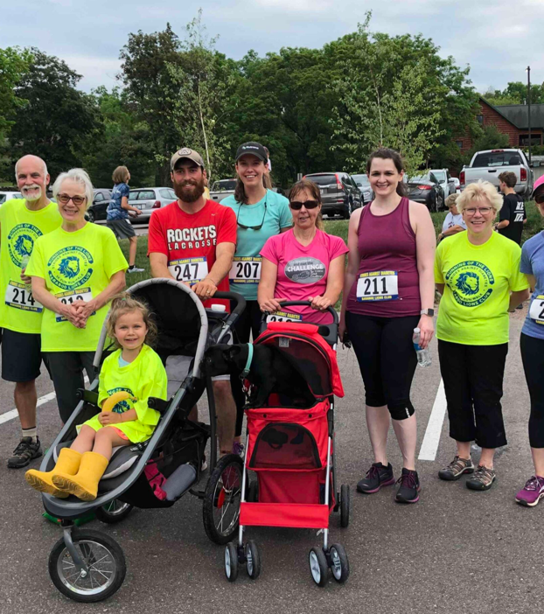
Strides for Diabetes Awareness
Lions & Leos can promote Diabetes
Awareness with a Strides event that can double as a fundraiser. Sample events:
• 5K/1-mile runs or walks
• Mall walking
• Screening & education fairs
• Dance events

Slide 21


Donate to Camp Kudzu
Help a child with Type 1 diabetes to attend this special camp for diabetic kids.

