Slide 1
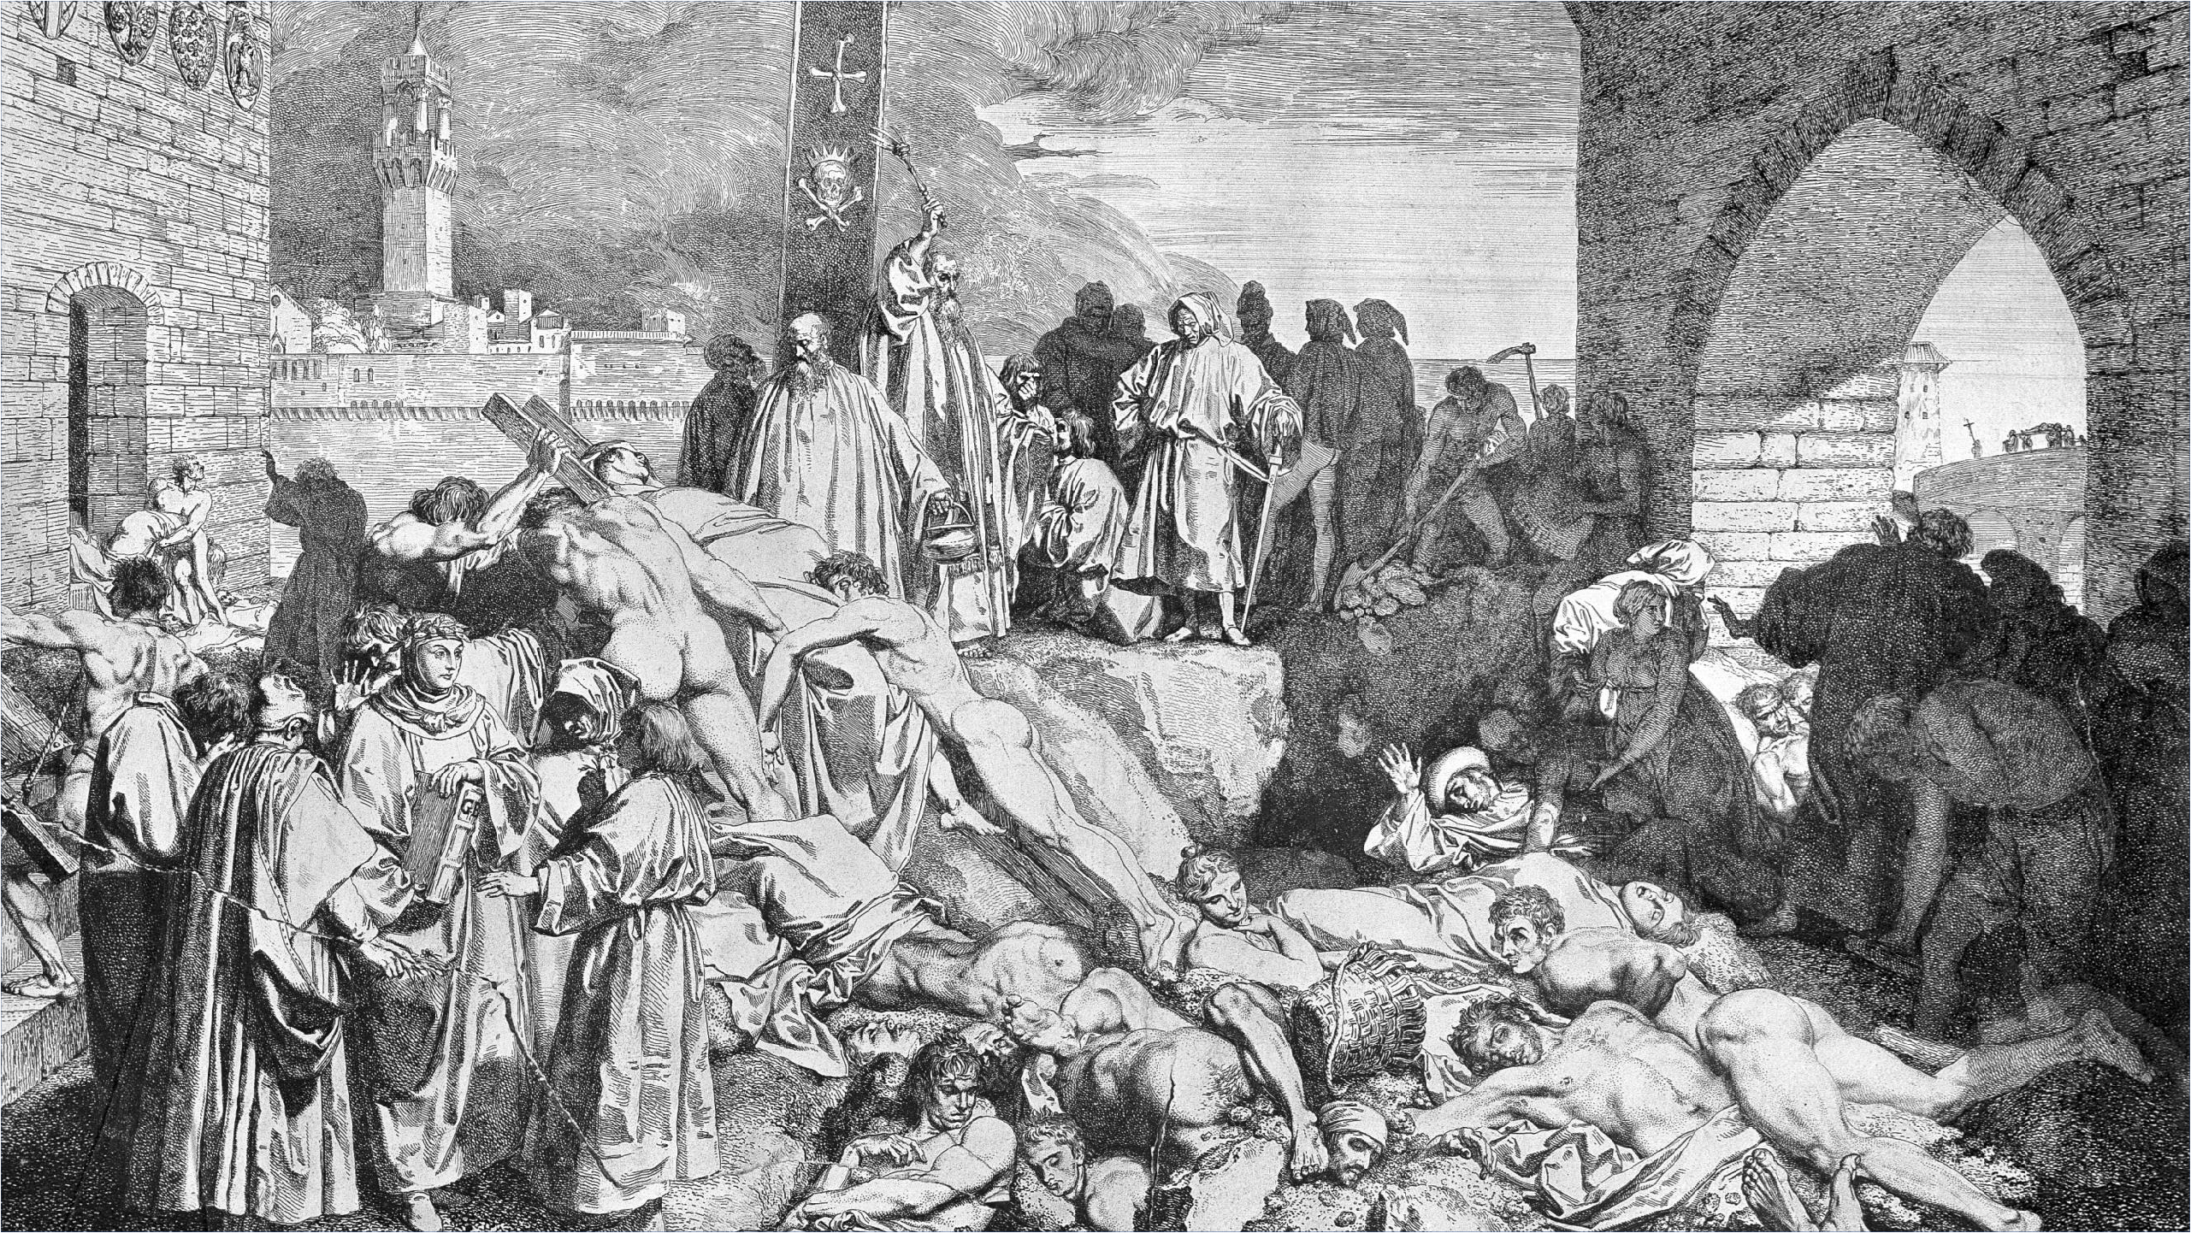




D^{T}I^{Y}A^{PE}B²ETES
The Largest Pandemic in Human History
?

Slide 2
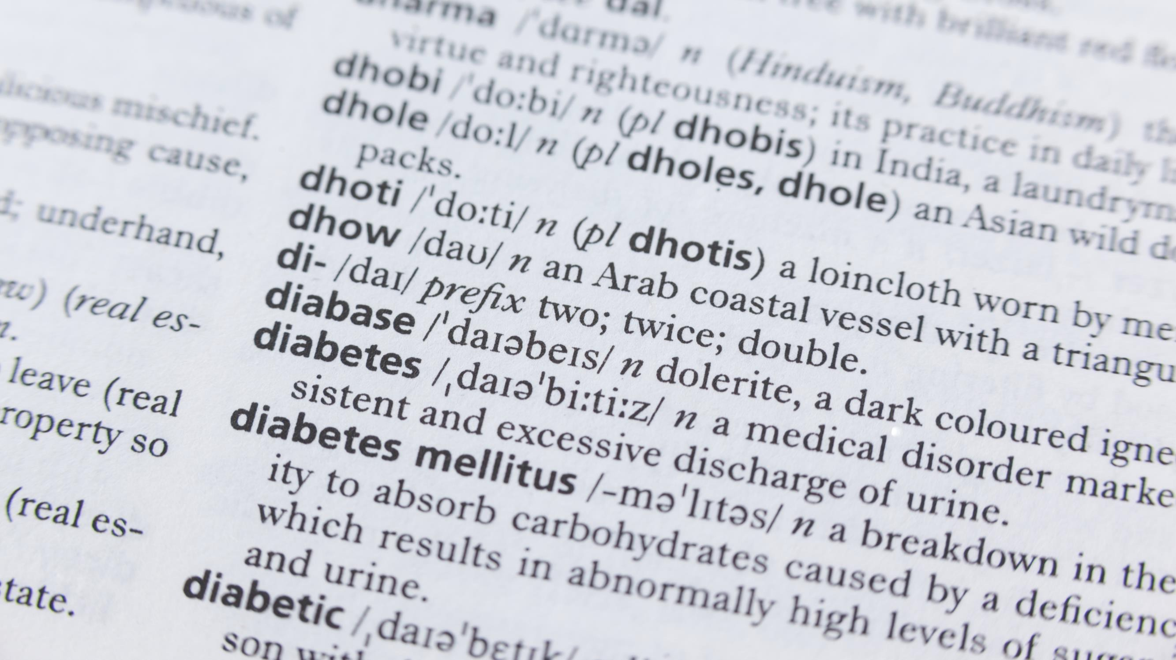





What is Diabetes?
2
Diabetes is a chronic condition that
affects how your body turns food into energy. People with diabetes have hyperglycemia, or too much sugar (glucose) in the bloodstream.
Uncontrolled, elevated glucose levels can damage tissues throughout the body, causing disease
and early death.

Slide 3






Typical* Signs and Symptoms
of Hyperglycemia
3
Frequent Urination Increased Thirst Increased Hunger Blurry Vision Weight Loss Fatigue
Cuts or Sores That Don’t Heal
* Note that you may have hyperglycemia without obvious symptoms!

Slide 4
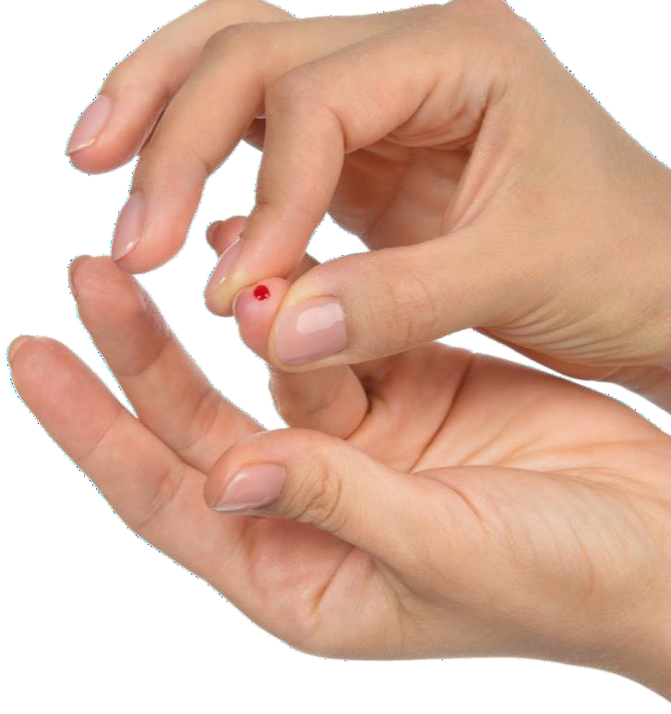



More Facts (for the USA):
4
>80
%
of the 98 million people with
Hyperglycemia don’t know it
1
20
%
of people with
Type 2 Diabetes
are yet undiagnosed¹
11.6%
38.4 million Americans have diabetes – and 1.1 million (12.1%) in Georgia²
At current trends, over 100 million will have diabetes by 2050!
¹ CDC – 2021 data
² The American Diabetes Association

Slide 5
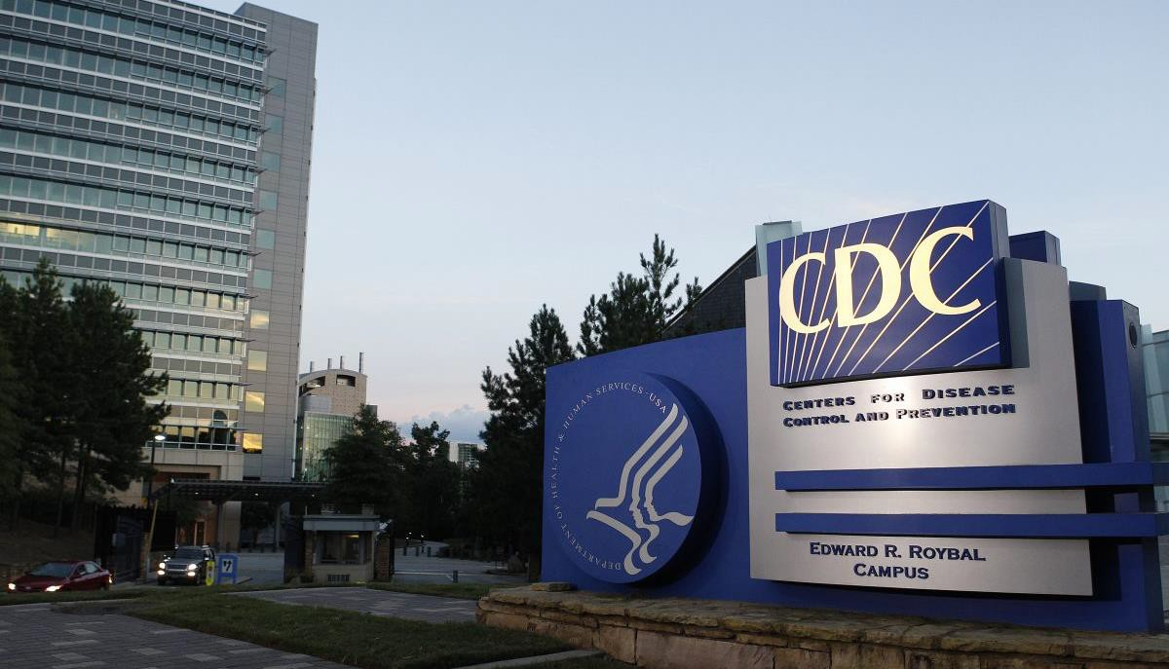



Facts:
5
According to the CDC…
Diabetes is the #1 cause of kidney failure, lower limb amputations, and adult onset blindness. It can also cause heart disease, impotence, and stroke.
Other conditions closely linked to diabetes include Alzheimer’s disease, polycystic ovary syndrome, and Cushing’s syndrome.

Slide 6








Financial Burden of Diabetes
6
$413B Total
Updated 2022
$307 billion for direct medical costs
$106 billion reduced productivity
Medical expenditures among people with diagnosed diabetes were 2.6 times higher than for those without
Sources: CDC & American Diabetes Ass’n

Slide 7

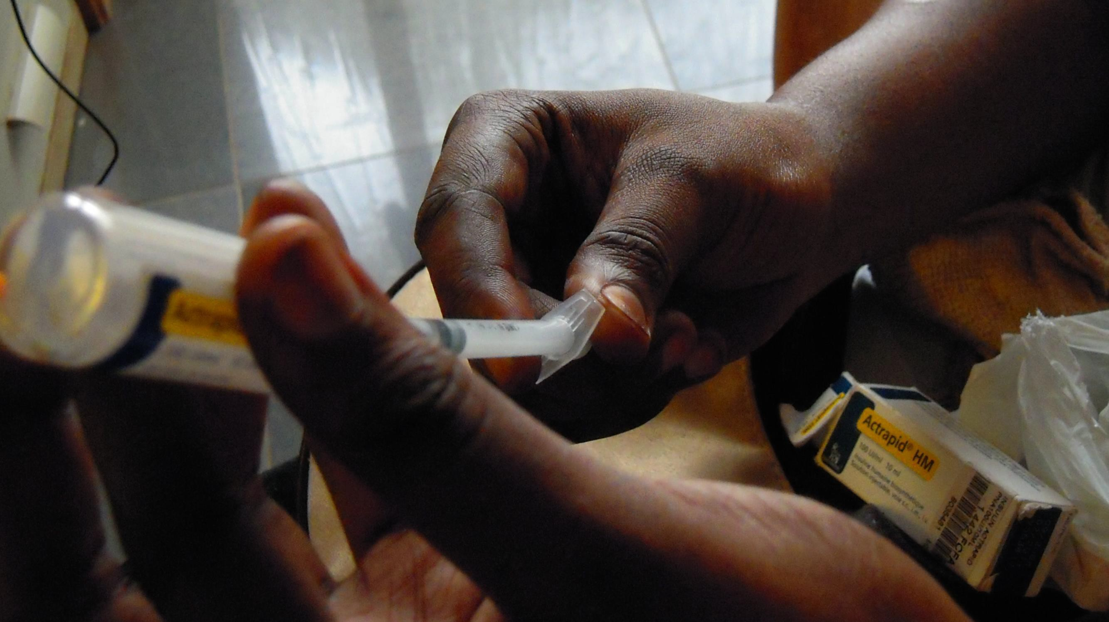

Care for a person with diabetes costs an
7
average of
$16,752
per year¹
¹ 2017 statistics from the American Diabetes Association

Slide 8


The Two Main Types of Diabetes
8
TYPE 1
(5%) The pancreas produces an insufficient amount of insulin.
The immune system damages or destroys the insulin-producing cells of the pancreas. Usually manifests early in life and requires lifelong insulin supplement.
TYPE 2
(90-95%) The body doesn’t make enough insulin to handle excess glucose or doesn’t use insulin well – a condition called insulin resistance.

Slide 9
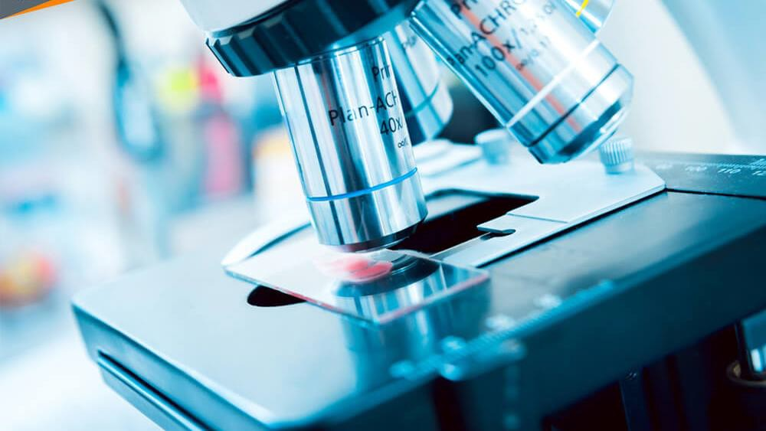




The Mission
9
TYPE 1
Type 1 diabetes has no cure, but it can be controlled.
TYPE 2
Type 2 diabetes has no cure, but it can be controlled.
Sometimes it may go into remission.
Our goal help you altogether or
Type 2 diabetes
.

Slide 10
Type 2 Diabetes Risk Factors
10
Age 45+ | Overweight or obese
Genetic predisposition | High blood pressure
Specific Ethnicities: African-American, Latino, Native American, Asian | Inactive/sedentary lifestyle
 | High cholesterol
History of gestational diabetes | History of cardiovascular disease
The average age of Lions is >60.
Are you at risk?
Source & Copyright: American Diabetes Association

Slide 11

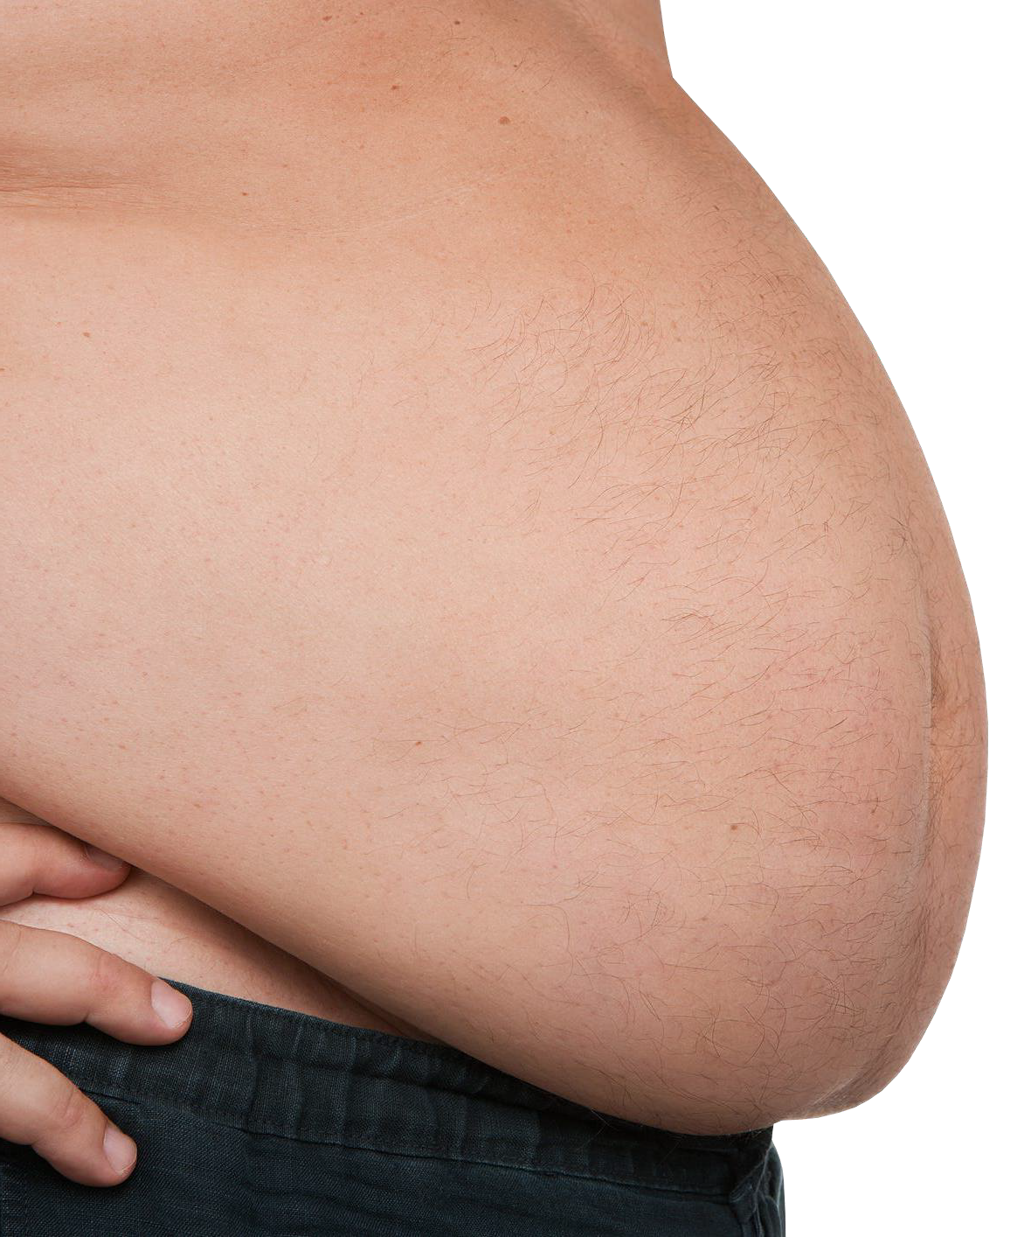

11
According to the American Diabetes Association, Type 2 diabetes is often
(but not always) tied to overweight
Obesity is
a HUGE
Factor
or obesity.
Your risk increases with weight: 12% of overweight adults and 21% of obese adults have Type 2 diabetes.*
*WebMD

Slide 12
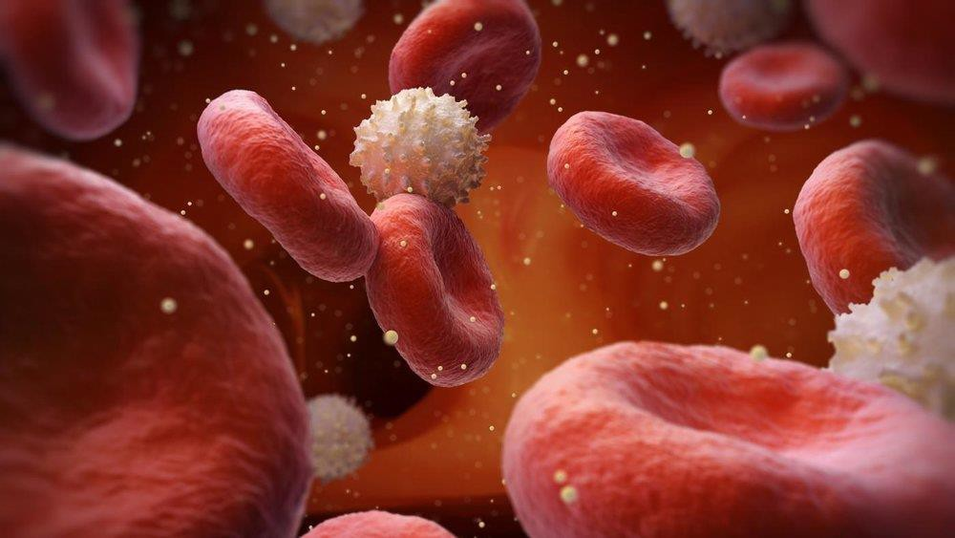












A Mechanism for Hyperglycemia & Type 2 Diabetes:
12
Obesity, Fatty Liver, & the Pancreas
1
3
2
Fat from the liver “spills over” into the adjacent pancreas, and “clogs” it.
Excess fat in the body deposits into the liver, creating a “fatty liver” condition.
The clogged pancreas loses some of its capacity and effectiveness for generating insulin in response to the body’s needs.
4
Hyperglycemia (and diabetes) follow.

Slide 13
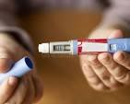
New GLP-1 Agonist drugs can reduce appetite & obesity
13
Advantages
Can induce rapid, significant weight loss & lower blood sugar
Have other health benefits for many patients
Disadvantages
Expensive
Rebound weight gain possible
Long term risks not fully evaluated, e.g. retinopathy

Slide 14


What is Prediabetes?
14
Prediabetes occurs when blood sugar levels are higher than normal but not as high as they would be in diabetes.
PEOPLE WITH PREDIABETES ARE AT RISK OF DEVELOPING DIABETES.
Doctors usually diagnose prediabetes at a fasting glucose level of 100 milligrams per deciliter (mg/dl) and diabetes at 126 mg/dl.

Slide 15
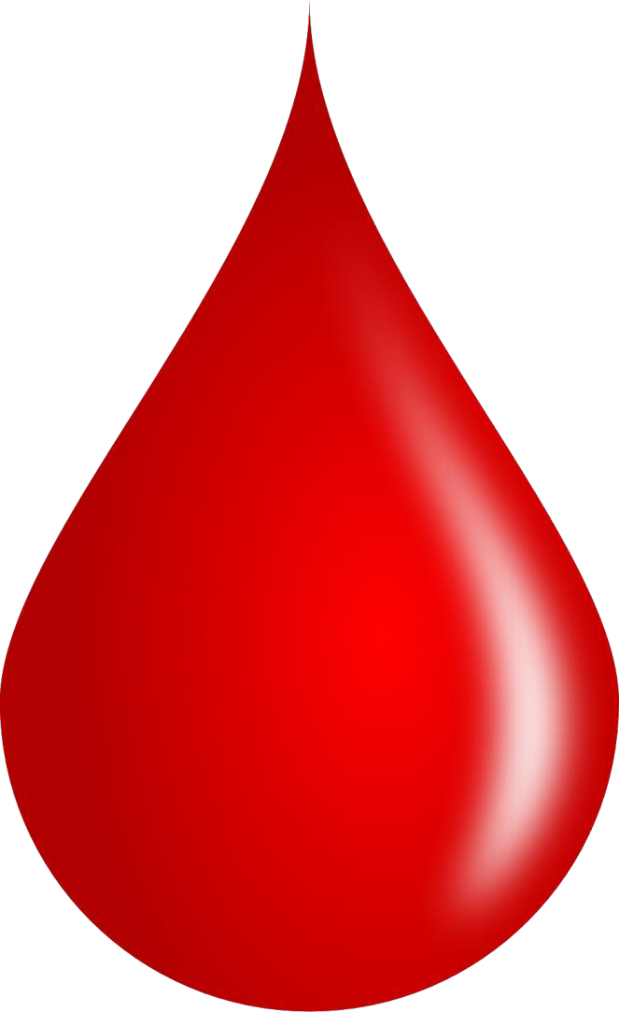

Why is Prediabetes important?
15
84 million people
– 34% of US adults – have prediabetes, which raises short-term absolute risk of Type 2 diabetes by 3- to 10-fold.¹⁻²
Overall, up to 70% of people with prediabetes may develop Type 2 diabetes during their lifetimes.³
¹ CDC, National Diabetes Statistics Report, 2017.
² Circulation. 2000 & 2005
³ Diabetes Care. 2007

Slide 16
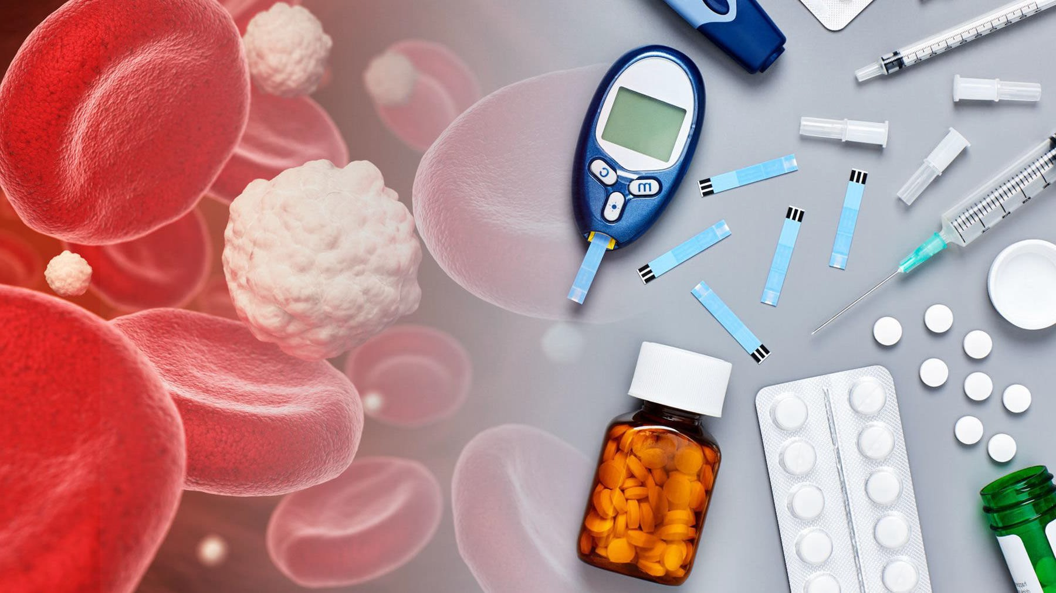


Why are Awareness & Early Diagnosis Critical?
16
Diabetes is often a “silent” disease.
It can do significant, extensive & irreversible damage to the body before you know it.
The good news is that Type 2 diabetes is reversible if you address it before major damage occurs.

Slide 17
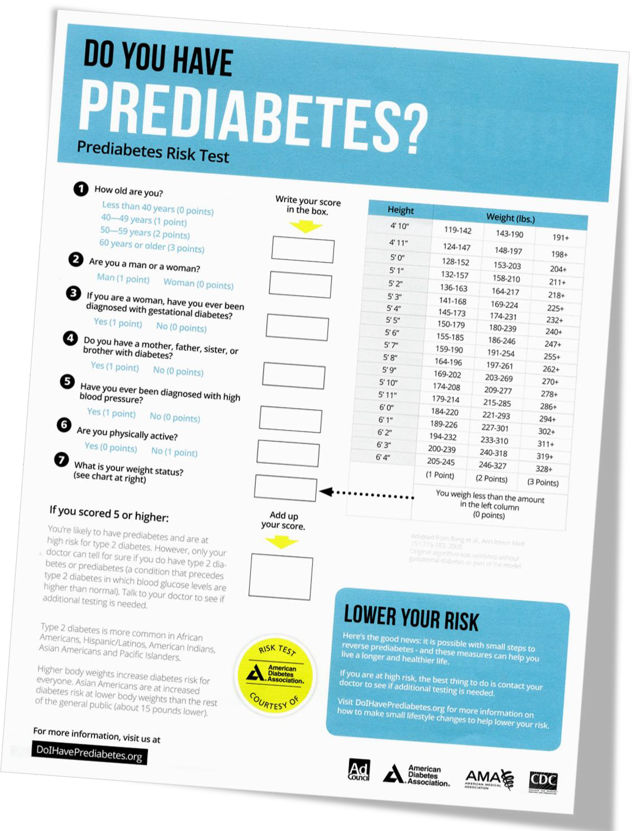

1 MINUTE
Prediabetes Risk Test
17
Take the
Courtesy of the American Diabetes Association

Slide 18











If the test shows you are at risk, then follow up with a visit to your healthcare provider.
18
You may not have
prediabetes…
But isn’t it better to know?

Slide 19

You can Make a Difference
19
– in your Health
Adopting simple lifestyle changes now may help you to:
1
Live a longer & healthier life
2
Avoid diabetes or prediabetes altogether
3
Treat your prediabetes or diabetes;
even reverse it!
4
Reduce future medical & insurance expenses

Slide 20



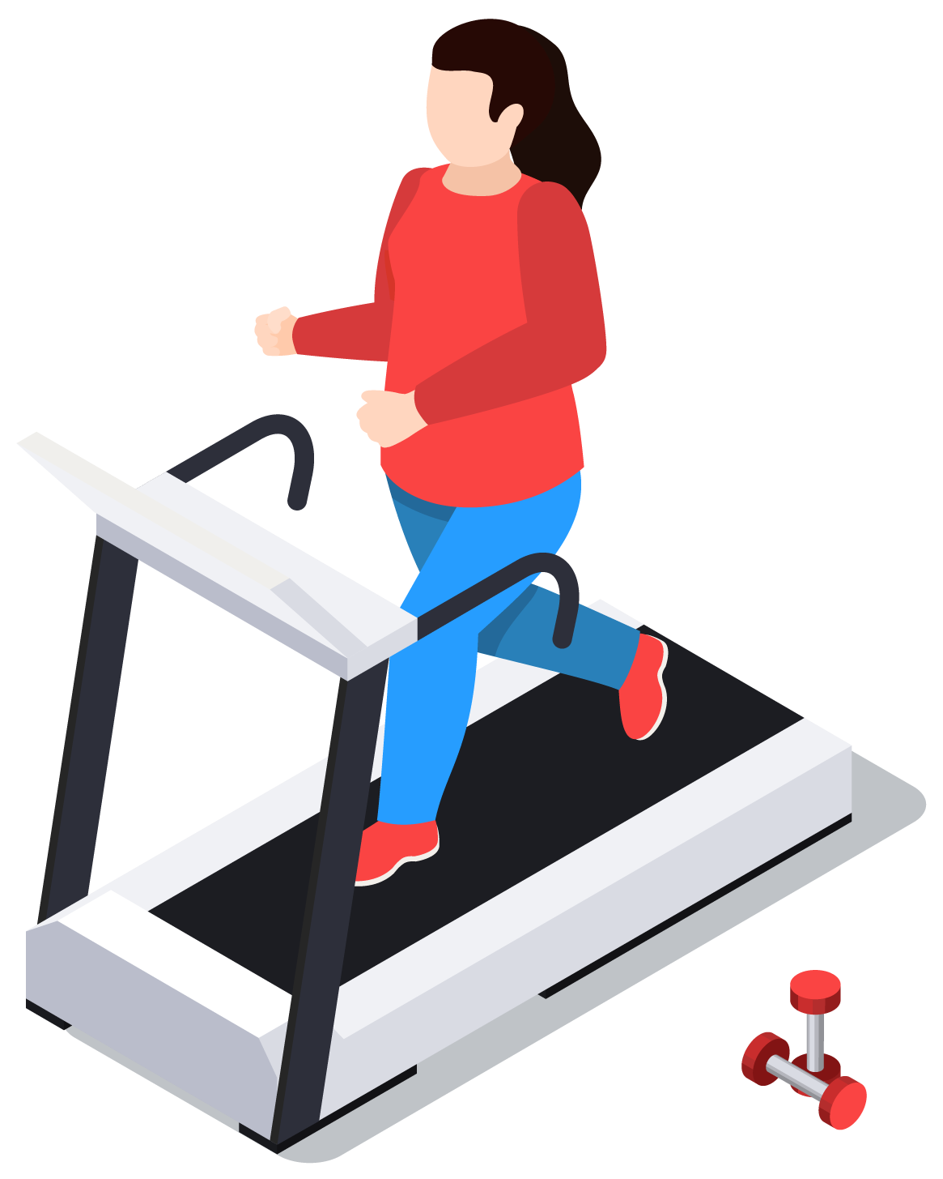
What are the Basic Lifestyle Changes / Interventions?
20
1
2
3
4
Try to lose 5-10% of your body weight.
Aim for 30 to 60 minutes of daily moderate physical activity.
Choose foods low in fat and calories and high in fiber; eat more vegetables.
Reduce your carbohydrate intake.

Slide 21
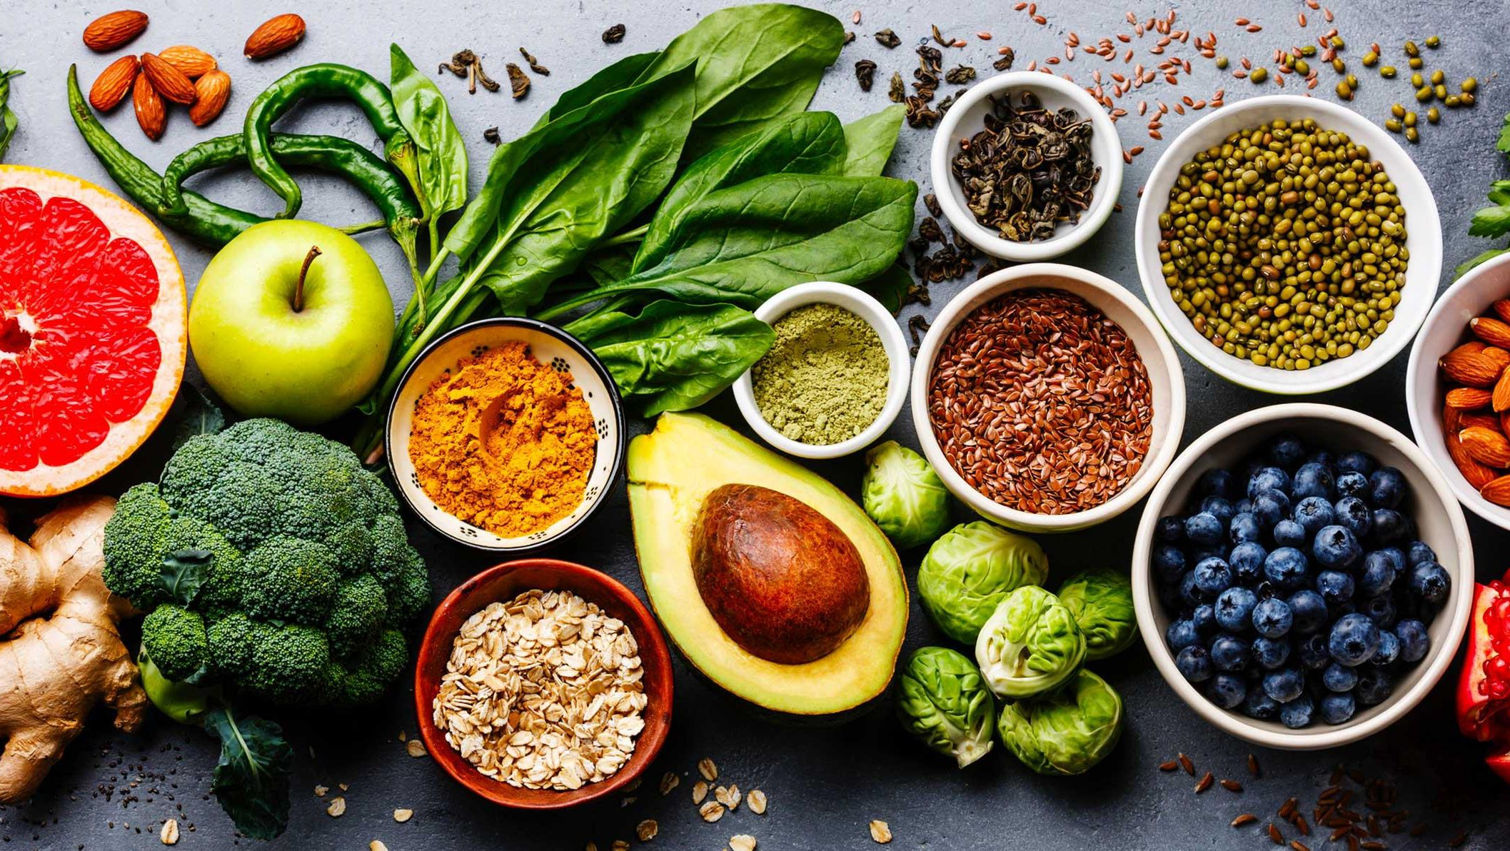

Dietary Patterns & Health Benefits
21
Health Benefits* | Reduced Risk of Diabetes | A1C Reduction | Reduced Risk of Heart Disease (CVD) | Weight Loss | Lowered Blood Pressure
Mediterranean Diet
Vegetarian & Vegan Diets
Low-Carb & Very Low-Carb Diets
Low-fat Diet
Very Low-fat Diet
DASH Diet (Dietary Approach to Stop Hypertension)
Paleo Diet | Mixed Results. Inconclusive evidence.
Source: Random Clinical Trials (RCTs), Meta-Analyses, Observational Studies, non-randomized single-arm studies, cohort studies.
Nutrition Therapy for Adults With Diabetes or Prediabetes: A Consensus Report
Evert et al, Diabetes Care Apr. 2019

Slide 22

Intermittent Fasting (IF) to Lose Weight*
22
Popular Approaches:
TIME-RESTRICTED FEEDING
Restrict daily eating to a 6-8 hour window with no calories outside of the window.
WEEKLY IF REGIMENS
“Alternate-day fasting” and “5-2 Fasting”(eat 5 days, fast 2)
*New England Journal of Medicine, Effects of Intermittent Fasting of Health, Aging and Disease, Dec. 26, 2019.

Slide 23


Caveats
re: Intermittent Fasting (IF)
23
It’s not for everyone. Consult with your primary care provider before starting any dietary intervention, especially IF.
Studies are lacking on the immediate to long-term effects of IF, and risks are not fully known.
Because of the unknowns, the American Diabetes Association and Emory’s Global Diabetes Research Center (EGDRC) are not recommending IF. Instead, both recommend a gradual change in diet and increase in exercise.

Slide 24

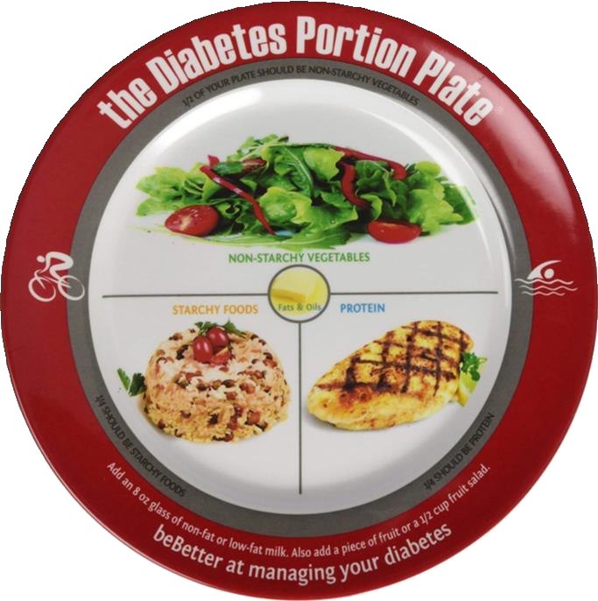


Helpful Tools
24
Electronic scale
Portion plate
Smartwatch

Slide 25


Becoming a Lions diabetes prevention advocate
25
Starting a competition to lose weight, reduce BMI, etc. within your own club or competing against other Lions clubs
Educating the community about diabetes as a Lions project

Slide 26
For More Information and Resources:
Lions Diabetes Website:
http://diabetes-partners.org
Jon Yaeger jonathan.Yaeger@gmail.com
(404) 610-9386 (cell)
ALSO

